Slide 1
Valorization of Biomass Pyrolysis By-Products for Heat Production in the Ontario Steel Industry: A Techno-Economic Analysis
Jamie Rose​
PhD Student​
Supervised by Dr. Thomas A. Adams II
McMaster University – Department of Chemical Engineering​
Canadian Chemical Engineering Conference
October 26, 2021​

Slide 2
Collaborations and Thanks
This project is being done in collaboration with:
ArcelorMittal Dofasco – Iron and steel plant info information
NRCan – Pyrolysis product composition data
CHAR Technologies – Large-scale pyrolysis process information

Slide 3
Iron Ore
Iron (Hot Metal)
4.5 Mt
Blast Furnace
Biomass (Wood)
Pulverized Coal
Biochar
Biomass Pyrolysis
0.45 Mt
$$$
Light Gases
Bio-oil/Tar
H₂, CO,
CO₂, CH₄
Water, Acids, Phenols, Furans, MeOH, VOCs
Corrosion,
Fouling

Slide 4
Literature Until Now and Current Gaps
The following has been studied:
Value of by-products of waste tire pyrolysis
(Czajczyńska et al., 2017), (Campuzano et al., 2020)
Use of biomass pyrolysis by-products for self-sustaining pyrolysis
(Crombie and Mašek, 2014), (Xu et al., 2011)
Techno-economic analysis and value of bio-oil plants
(Palma et al, 2011),(Badger et al., 2011)
Heating value of pyrolysis products
(Dunnigan et al., 2018)
There are no comprehensive analyses that cover or compare:
Several by-product usage methods
Techno-economic analysis of each method
Life-cycle carbon emissions and environmental impact
Methods to remove bio-oil before it condenses

Slide 5
Iron Ore
Iron (Hot Metal)
10 Mt
Direct Reduced Iron (DRI)
Blast Furnace
Biomass (Wood)
Biochar
Biomass Pyrolysis
1 Mt
$$$
Light Gases
Bio-oil/Tar
Treat as
Waste
(Status Quo)
Combust
for Heat
Sell Bio-oil
as Product
Syngas Production

Slide 6
Heat Generation Uses
Heat can be used for:
Self-sustaining pyrolysis – replaces NG
Electricity generation – done with NG
Process units (e.g. boilers) – replaces NG
Basically, it replaces natural gas in Ontario
Pyrolysis feedstock assumed to be waste wood
Combustion of by-products is therefore carbon neutral

Slide 7
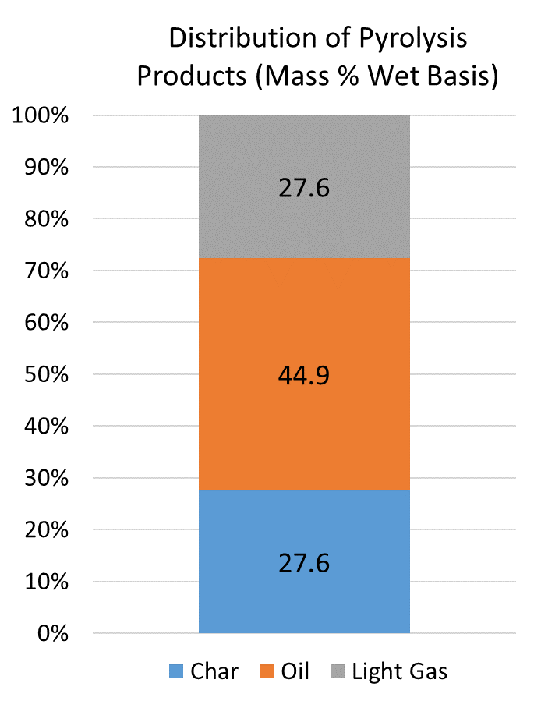
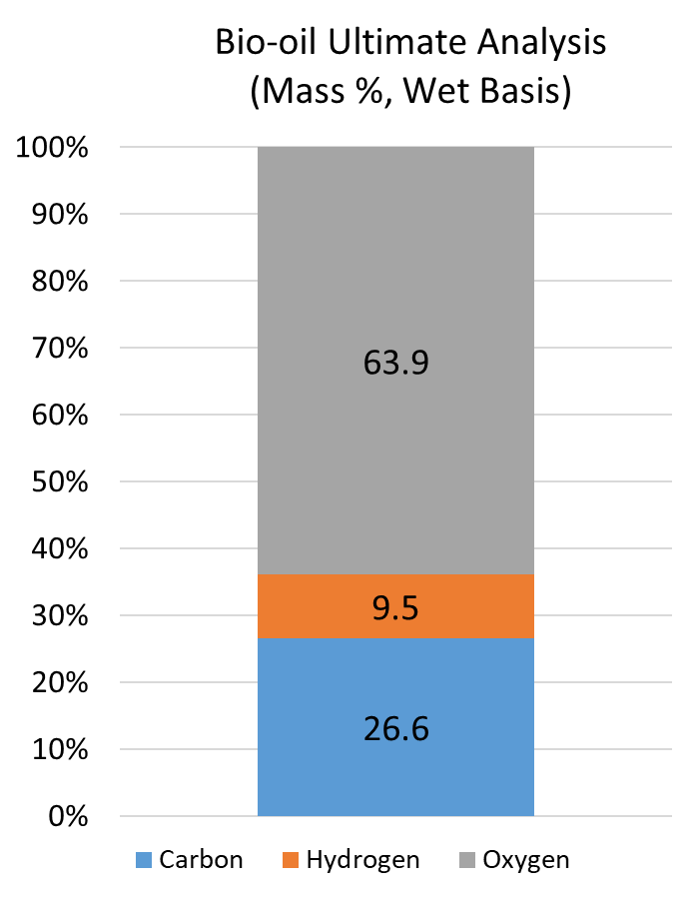
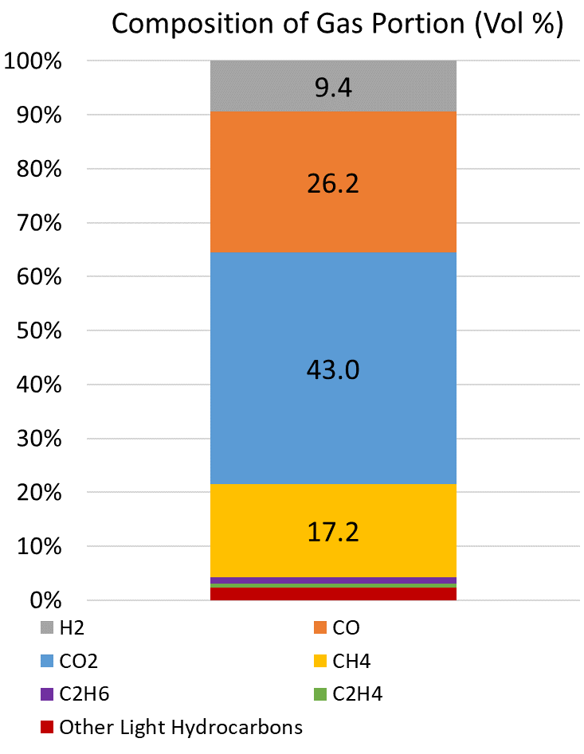
Combustion for Heat Generation
I do not look at this in my research
Data from NRCan for 600 °C Pyrolysis of Construction and Demolition Wood

Slide 8
Heat Generation Process
By-products can be combusted with an enclosed flare, also known as a vapour combustor (Anguil, n.d.)
Ideal for combustible waste streams that contain little or no oxygen (Gulf Coast Environmental Systems, n.d.)
Allows for bio-oil combustion before condensation
Vapour combustor cost for a 40 kilotonne biochar/year example plant:
1,126,000 CAD₂₀₂₁ total capital cost
335,000 CAD₂₀₂₁ annual operating cost
Net cost of 9.8 CAD₂₀₂₁ per tonne of biochar produced over 20 years
Reference: (United States Environmental Protection Agency, 1980)

Slide 9
Heating Value and Combustion Determination
Aspen Plus used to model combustion products
Light gas and bio-oil compounds added to model
PR-BM equation of state was used
RGIBBS block, which minimizes ΔG, used to determine combustion products
Target oxygen outlet concentration of 2% by volume, as per ArcelorMittal Dofasco
Higher heating value calculated with the Aspen Plus QVALGRS function
Calculates higher heating value by taking the sum of component heating values
By-Product Stream | HHV (MJ/kg)
Light Gases | 10.9
Bio-Oil | 11.4
Net By-product Mix | 11.2
Blast Furnace Gas (Deng & Adams, 2020) | ~2.5
Coke Oven Gas (Deng & Adams, 2020) | ~27.5
Natural Gas | 54.3

Slide 10
Results and Cost Savings
Assuming 20-year project lifetime at 40 kilotonnes of biochar/year
Parameter | Value
By-product Heat / tonne biochar | 29.4 GJ_{HHV}
Annual Heat Available | 1,176,000 GJ_{HHV}
Net Natural Gas Price (with carbon tax) (Ontario Energy Board, 2021) | 6.00 CAD₂₀₂₁/GJ_{HHV}
Levelized Savings from NG Offset (includes Vapour Combustor Cost) | 167 CAD₂₀₂₁/tonne biochar
NG Emission Factor (Environment and Climate Change Canada, 2020) | 0.0504 tCO₂e/GJ_{HHV}
Annual Emissions Reduction | 59,600 tCO₂e

Slide 11
Conclusion
Biochar cost can be viewed as 167 CAD₂₀₂₁/tonne cheaper than it actually is
Annual savings of 7.0 million CAD₂₀₂₁ at 40 kt/year
At 2030 carbon tax of 170 CAD/tCO₂e
Save 343 CAD/tonne biochar
Total of 14 million CAD per year
40kt per year reduces annual emissions equivalent to 25,000 cars (Wynes & Nicholas, 2017)
Equivalent to 670,500 tCO₂e or 280,000 cars when scaled to all of ArcelorMittal Dofasco
Promising first step in increasing the value of biochar through by-product utilization!

Slide 12
References
[1] Czajczyńska, D., Krzyżyńska, R., Jouhara, H., & Spencer, N. (2017). Use of pyrolytic gas from waste tire as a fuel: A review. Energy, 134, 1121–1131. https://doi.org/10.1016/j.energy.2017.05.042
[2] Campuzano, F., Abdul Jameel, A. G., Zhang, W., Emwas, A.-H., Agudelo, A. F., Martínez, J. D., & Sarathy, S. M. (2020). Fuel and Chemical Properties of Waste Tire Pyrolysis Oil Derived from a Continuous Twin-Auger Reactor. Energy & Fuels, 34(10), 12688–12702. https://doi.org/10.1021/acs.energyfuels.0c02271
[3] Crombie, K., & Mašek, O. (2014). Investigating the potential for a self-sustaining slow pyrolysis system under varying operating conditions. Bioresource Technology, 162, 148–156. https://doi.org/https://doi.org/10.1016/j.biortech.2014.03.134
[4] Xu, R., Ferrante, L., Hall, K., Briens, C., & Berruti, F. (2011). Thermal self-sustainability of biochar production by pyrolysis. Journal of Analytical and Applied Pyrolysis, 91(1), 55–66. https://doi.org/10.1016/j.jaap.2011.01.001
[5] Palma, M. A., Richardson, J. W., Roberson, B. E., Ribera, L. A., Outlaw, J., & Munster, C. (2011). Economic feasibility of a mobile fast pyrolysis system for sustainable bio-crude oil production. International Food and Agribusiness Management Review, 14(3), 1–16.
[6] Badger, P., Badger, S., Puettmann, M., Steele, P., & Cooper, J. (2011). Techno-economic analysis: Preliminary assessment of pyrolysis oil production costs and material energy balance associated with a transportable fast pyrolysis system. BioResources, 6(1), 34–47. https://doi.org/10.15376/biores.6.1.34-47
[7] Dunnigan, L., Morton, B. J., Ashman, P. J., Zhang, X., & Kwong, C. W. (2018). Emission characteristics of a pyrolysis-combustion system for the co-production of biochar and bioenergy from agricultural wastes. Waste Management, 77, 59–66. https://doi.org/10.1016/j.wasman.2018.05.004
[8] Anguil. (n.d.). Vapor Combustor Unit (VCU). https://anguil.com/air-pollution-control-solutions/vapor-combustor-unit-vcu/
[9] Gulf Coast Environmental Systems. (n.d.). Vapor Combustor Unit. http://www.gcesystems.com/air-pollution-control/vapor-combustor-unit.html
[10] United States Environmental Protection Agency. (1980). Organic Chemical Manufacturing Volume 4: Combustion Control Devices. https://nepis.epa.gov/Exe/ZyPDF.cgi/2000MF11.PDF?Dockey=2000MF11.PDF
[11] Deng, L., & Adams II, T. A. (2020). Techno-economic analysis of coke oven gas and blast furnace gas to methanol process with carbon dioxide capture and utilization. Energy Conversion and Management, 204, 112315. https://doi.org/https://doi.org/10.1016/j.enconman.2019.112315
[12] Ontario Energy Board. (2021). Natural Gas Rates. https://www.oeb.ca/rates-and-your-bill/natural-gas-rates
[13] Environment and Climate Change Canada. (2020). Emission Factors. https://donnees.ec.gc.ca/data/substances/monitor/canada-s-official-greenhouse-gas-inventory/Emission_Factors.pdf
[14] Wynes, S., & Nicholas, K. A. (2017). The climate mitigation gap: education and government recommendations miss the most effective individual actions. Environmental Research Letters, 12(7), 74024. https://doi.org/10.1088/1748-9326/aa7541

