Slide 1
A Detailed Mathematical Model for Evaluation of Solid Oxide Fuel Cells Performance Degradation
Mina Naeini (PhD candidate McMaster university)
Dr. J. Cotton, Dr. T. Adams

Slide 2
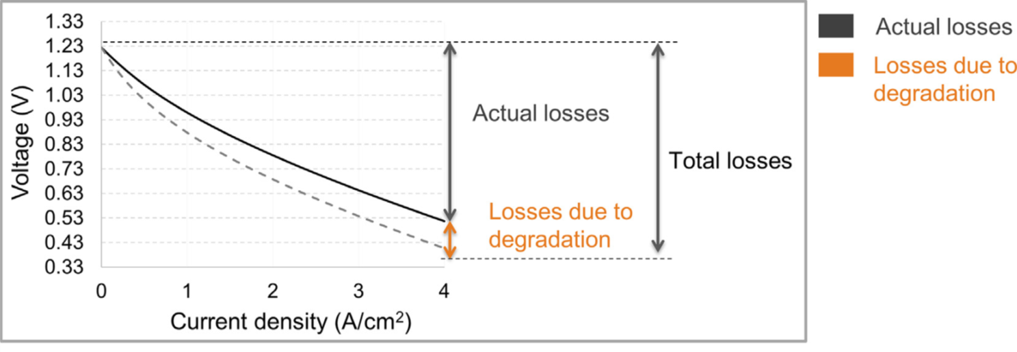
Performance degradation
$V(t) = E − (\sum_{k}{η_{ohm,k}\left(t\right)+ η_{act,an}\left(t\right)+ η_{act,ca}\left(t\right)+ η_{con,an}\left(t\right)+ η_{con,ca}(t)}$)
$E$ = Open-Circuit voltage
$η_{ohm}$= Ohmic polarization
$η_{con}$ = Concentration polarization
$η_{act}$ = Activation polarization
Parhizkar, T., & Roshandel, R. (2017). Long term performance degradation analysis and optimization of anode supported solid oxide fuel cell stacks. Energy conversion and management, 133, 20-30.

Slide 3
1
Performance degradation, makes it hard to find the proper sizing and operation of SOFCs for the communities.
2
Lack of a comprehensive model that accounts for the dominant degradation mechanisms in SOFCs prevents widespread commercialization of this technology.
1
2
3
3
Resolve the apparent conflict in the literature about whether temperature positively or negatively correlates to the SOFCs performance degradation.

Slide 4
M. Naeini, J.S. Cotton, T.A. Adams II, A mathematical model for prediction of long-term degradation effects in solid oxide fuel cells, J. Power Sources, Under review.

Slide 5
Thermodynamic equations
$η_{ohm}=IR$
$η_{ohm,ic}=I (\frac{Lic}{Lz Ly σic}+ \frac{Lfc}{\left(1+nch\right)Lt Ly σic}+\frac{Lac}{\left(1+nch\right)Lt Lz σic})$
$η_{ohm,ele}=I$($\frac{Lele}{Lz Ly σele(t) }$)
$η_{ohm,l}=I ( \frac{\left( A_{opt,l}\left(t\right)−Ly Lz \right) {L′}_{opt,l}}{ A_{opt,l}\left(t\right) Ly Lz (1−φl)σele(t)} + \frac{Ll−{L′}_{opt,l}}{Ly Lz \left(1−1.8φl\right) σl(t)} )$
$η_{con,ca}= \frac{RT}{nF} ln⁡(\frac{P_{O_{2}}}{P_{O_{2},TPB}(t)})$
$η_{con,an}= \frac{RT}{nF}\ln{(\frac{P_{H_{2}O,TPB }\left(t\right){ P}_{H_{2}}}{P_{H_{2},TPB}\left(t\right) P_{H_{2}O}})}$
$η_{act, l}= \frac{RT}{⍺nF} \sinh^{−1}\left(\frac{\left.i_{l}(t\right)}{2i_{0,l}}\right)$
$I=$ Current
$σ=$ Electrical conductivity
$L=$ Length
$A=$ Area
$T=$ Temperature
$n=$ Electrons associated with a reaction
$Pi=$ Partial pressure of species i
$il=$ Operating current density
$Pi=$ Exchange current density

Slide 6
System degradation mechanisms
$$η_{ohm,l}=I ( \frac{{(A_{opt,l}\left(t\right) − L_{y}L_{z})L′}_{opt,l}}{ A_{opt,l}\left(t\right) Ly Lz (1−φl)σele(t)} + \frac{Ll−{L′}_{opt,l}}{Ly Lz \left(1−1.8φl\right) σl(t)} )$$
$A_{opt, l} \left(t\right)=\left(1+2\frac{{L′}_{opt,l}}{D_{p, l} (t)}\right) L_{y} L_{z}$
$D_{p, an}\left(t\right)= D_{YSZ} ε_{YSZ}\left(t\right)+ D_{Ni}(t) ε_{Ni}\left(t\right)$
$σele(t) = (σ_{i}− σ_{f}) exp(−t/τ) + σ_{i}$
$Dp=$ Pore diameter
$Di=$ Particle size of species i
$ε_{Ni}$ = Volume fraction of species i

Slide 7
System degradation mechanisms Sulfur poisoning of hydrocarbon-fueled SOFCs
Previous models focused on performance loss in H₂-fueled SOFCs.
H₂S deactivates catalytic activity of SOFCs by reducing electrochemical activity and hydrocarbon conversion.
The models developed for H₂-fueled SOFCs cannot be used for hydrocarbon-fueled ones.

Slide 8
System degradation mechanisms Sulfur poisoning of hydrocarbon-fueled SOFCs
$∆V_{s}= W_{1} f_{1}\left(i, C_{H_{2}S}\right)+ W_{2} f_{2}\left(i, C_{H_{2}S}\right)$
$f_{1}\left(i, C_{H_{2}S}\right)= ln(C_{H_{2}S})$
$$f_{2}\left(i, C_{H_{2}S}\right)= Y_{max}\left(i\right)(1− A_{1}\left(i\right) \exp\left(−A_{2}\left(i\right) × C_{H_{2}S}\right))$$
$W_{1}$ and $W_{2}$ = Weighting factors
Experimental data from: A. Hagen, G.B. Johnson, P. Hjalmarsson, Electrochemical evaluation of sulfur poisoning in a methane-fuelled solid oxide fuel cell: Effect of current density and sulfur concentration, J. Power Sources. 272 (2014) 776–785.

Slide 9
Validation of the model
Voltage profile over time for the SOFC running at 750℃ and 0.75 A/cm²
Experimental data from: A. Hagen, R. Barfod, P.V. Hendriksen, Y.L. Liu, S. Ramousse, Degradation of anode supported SOFCs as a function of temperature and current load, J. Electrochem. Soc. 153 (2006) 1165–1171.

Slide 10
Voltage loss and degradation rate
Voltage profile over time, and Degradation rate percentage per 1000 hours versus time for the SOFC running at 750℃ and 0.5 A/cm², with pure hydrogen.

Slide 11
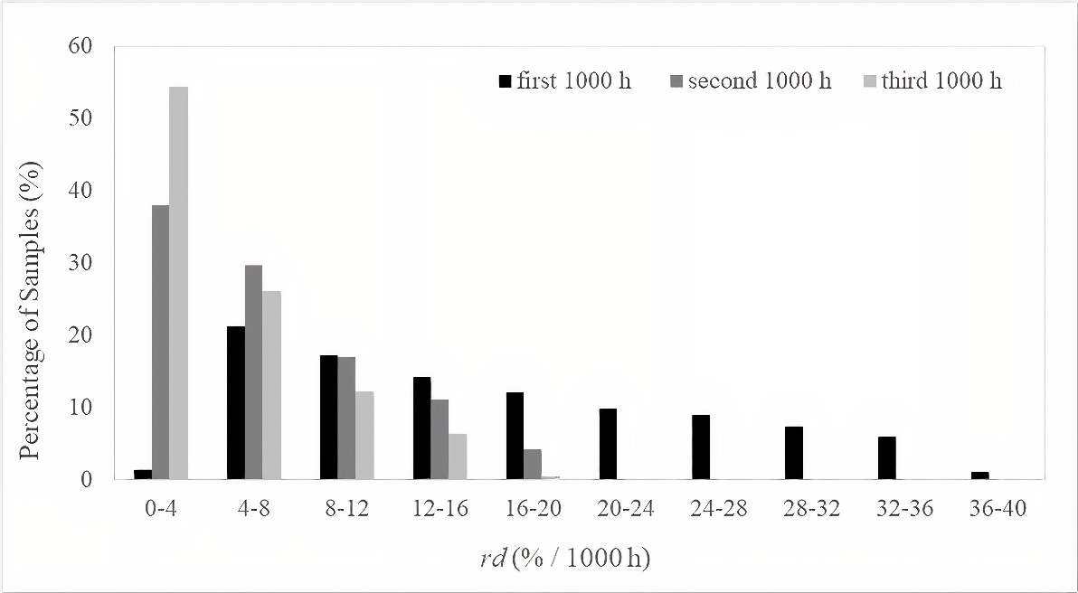
Sensitivity analysis
Generate 6000 random operating conditions
Current density (0.2-1 A/cm²), Temperature (873-1173 K), H₂ partial pressure (70%-90% of the fuel pressure)
Simulate 3000 hours of operation of SOFCs at each condition
Calculate average degradation rates over the first, second, and third 1000 hours of operation for each random sample

Slide 12
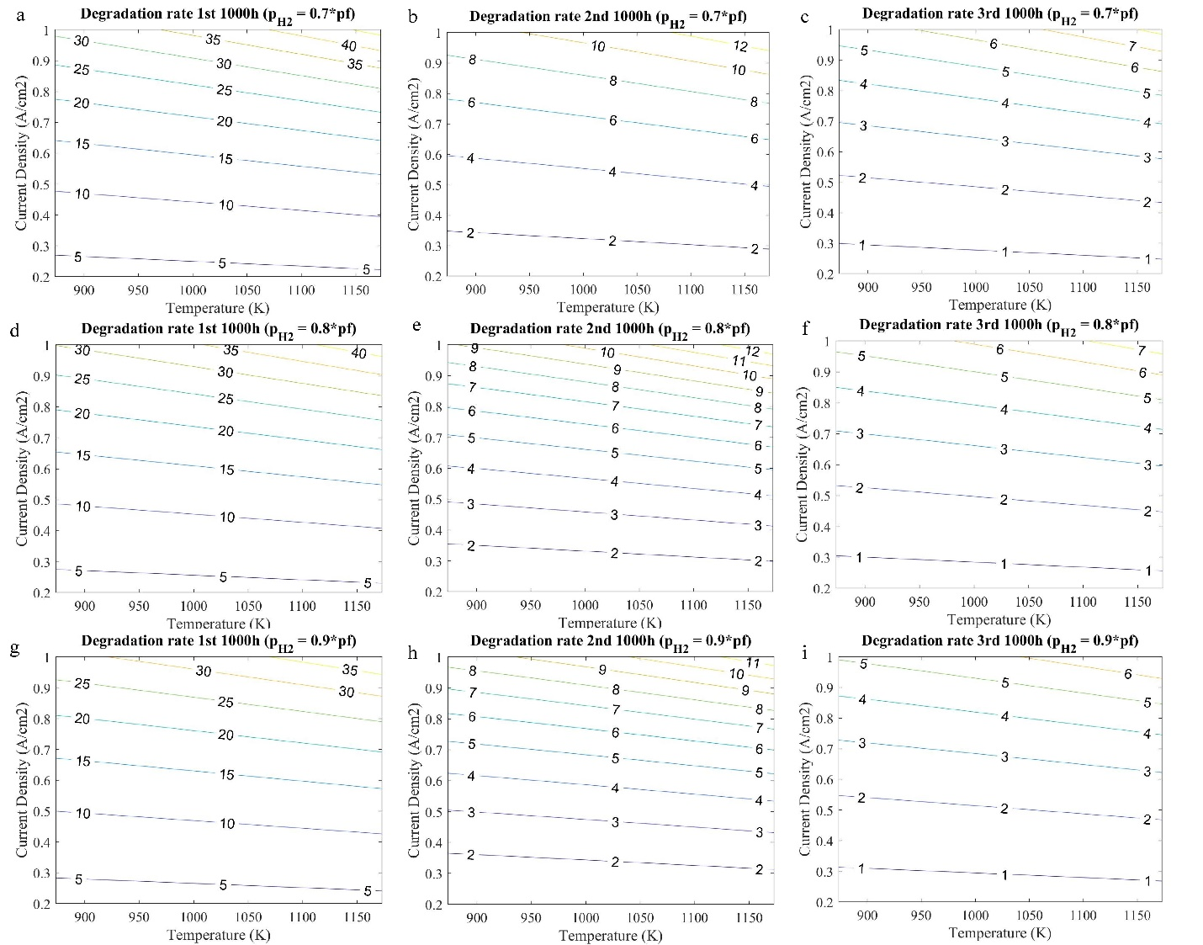
Sensitivity analysis

Slide 13
Conclusion
The first complete model of long-term SOFCs performance degradation
Combined information from the literature with very little parameter fitting
Validated on literature data not used to develop the model

Slide 14
THANK YOU

