Slide 1

Design and Eco-techno-economic Analyses of SOFC/Gas Turbine Hybrid Systems Accounting for Long-Term Degradation
ESCAPE 30
September, 2020
Haoxiang (Hundey) Lai ª
Nor Farida Harun ^{b}
David Tucker ^{b}
Thomas A. Adams II ^{a*}
ª McMaster University, Department of Chemical Engineering, Hamilton, ON, Canada
^{b} US Department of Energy, National Energy Technology Laboratory, Morgantown, WV, USA
* Corresponding Author. tadams@mcmaster.ca

Slide 2
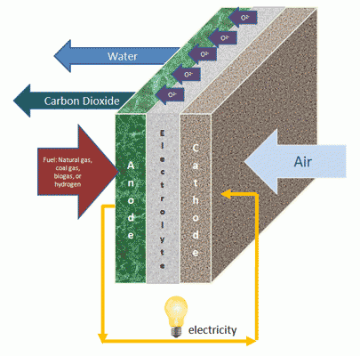
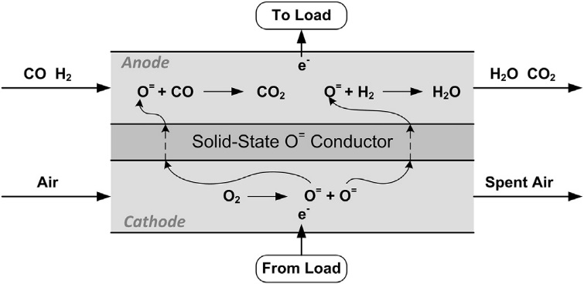
SOFC Overview
High electrical efficiency ~60% (cell level)
Lower greenhouse gas emission than conventional power plant (coal/natural gas power plant)
Sources: U.S. DOE, Also: Materials System Research, Inc.
Adams, Nease, Tucker, & Barton. I&EC Research (2013)

Slide 3
Research Motivation
Challenge: SOFC degrades over time
New!
Operating Mode | Constant Power Mode | Constant Voltage Mode
SOFC Degradation | Fast (and increasing) | Slow
Lifetime | Up to ~1.5 years | 13 – 14 years
Power output | Constant (baseload power) | Decreasing, not useful for baseload
Fuel | Increasing fuel flow | Increasing unspent fuel flow
    For baseload power production, one solution is to be coupled with gas turbine (GT) in a SOFC/GT hybrid system* Key discovery
Source: Tucker Sepulveda, and Harun, Journal of Fuel Cell Science and Technology (2014)

Slide 4
SOFC/GT Hybrid System
Operated in constant voltage mode
Power decreases as SOFC degrades
Over-size turbine (sized at the end of lifetime of SOFC)
Power increases to almost make up for the SOFC power losses

Slide 5
Research Goal
We would like to answer whether it is better to have
An SOFC standalone plant (Case i)
SOFC constant power mode, replace SOFC more frequently (short lifetime)
2. An SOFC/GT hybrid plant (more expensive) (Case ii)
SOFC constant voltage mode, replace SOFC less frequently (much longer lifetime)
Plant scale: 550 MW Plant lifetime: 30 years
The first system-level eco-techno-economic analysis of SOFC/GT hybrid plant accounting for long-term degradation
Contribution to the early large-scale adoption of SOFC from a system-level perspective

Slide 6
SOFC Standalone Plant (Case i)

Slide 7




SOFC/GT Hybrid Plant (Case ii)
Dynamic model*, pause in each time step (weekly)
Pseudo steady-state approach
Integrate models by using interfaces:
Aspen Excel Workbook & VBA
Matlab
Aspen Plus steady-state model
Source: Zaccaria, Tucker, and Traverso, Journal of Power Sources (2016)

Slide 8
Results
SOFC Standalone Plant (Case i)
SOFC lifetime: ~ 3132 hours = ~ 19 weeks
Constant power and fuel utilization

Slide 9
Results
SOFC/GT Hybrid Plant (Case ii)
SOFC lifetime: ~ 351 weeks = ~ 6.7 years
Constant power and fuel utilization

Slide 10
Results
For plant lifetime of 30 years
 | SOFC Standalone Plant | SOFC/GT Hybrid Plant
SOFC Stack Efficiency (LHV) | 57.9 % | 66.2 %
Overall Plant Efficiency (LHV) | 30.7 % | 41.8 %
First year Capital Cost ($ Million) | $7,216 | $4,129
Average Annual SOFC Replacement Cost ($ Million) | $3,048 | $109
Annual Material, Operating and Maintenance Cost ($ Million) | $421 | $398
LCOE ($/MWh) | $426 | $85
CO₂ Emission (kg/MWh) | 673 | 493

Slide 11
Conclusion
Proposed and designed SOFC Standalone plant (Case i) and SOFC/GT Hybrid plant (Case ii)
Model simulations with a pseudo steady-state approach
The result of eco-techno-economic analysis shows that SOFC/GT Hybrid plant has higher efficiency, lower costs, and lower greenhouse gas emission.
SOFC/GT Hybrid can be a promising near-term approach for baseload power production
Future Work
Design and investigate cases with steam bottoming cycle
Optimize the replacement time of SOFC stack (SOFC lifetime) in the hybrid case
Sensitivity analysis

Slide 12



Thank you
Acknowledgements

