Slide 1
Techno-Economic Analysis of Combining Petroleum Coke and Natural Gas for Efficient Liquid Fuels Production
Ikenna Okeke PhD Student
Dr. Thomas A. Adams II Supervisor
68th Canadian Chemical Engineering Conference
Toronto 2018
Dr. Adams Group http://PSEcommunity.org/LAPSE:2018.0618

Slide 2
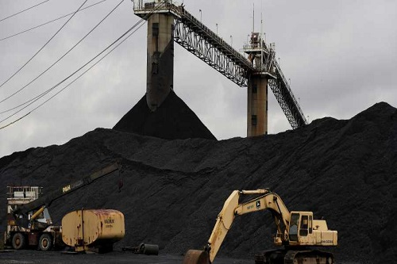
Background
Petroleum coke (petcoke):
Refinery undesired solid waste
Up to 40% of heavy oil feed
High petcoke deposits in Canada:
Jacob Consults: 100 million tonnes (2016)
Storage limitations
Petcoke disposal:
Indiscriminate stockpiling
Environmental concerns
https://stockbrokernews24.com/6007/global-petroleum-coke-petcoke-market-2018-shell-valero-energy-asbury-carbons-reliance-aluminium-bahrain/
Dr. Adams Group

Slide 3
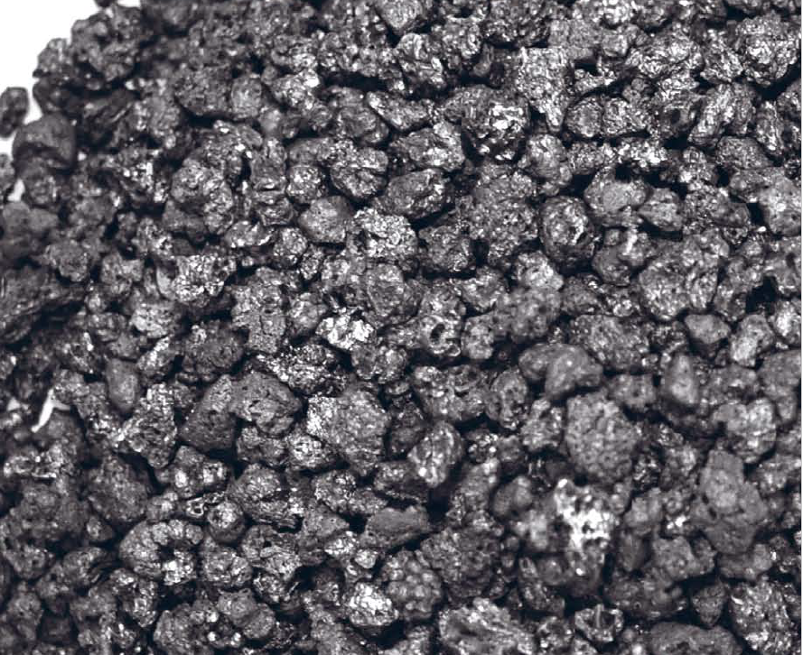
Motivation
Petcoke as free fuel source
Instead of stockpiled, clean utilization of petroleum coke
Gasification to liquid fuels
Reduction in fossil fuel usage
Displaces some fossil derived fuels
Potential reduced environmental impacts
CCS technology + fossil fuel displacement
OilChange International 2013
Dr. Adams Group

Slide 4
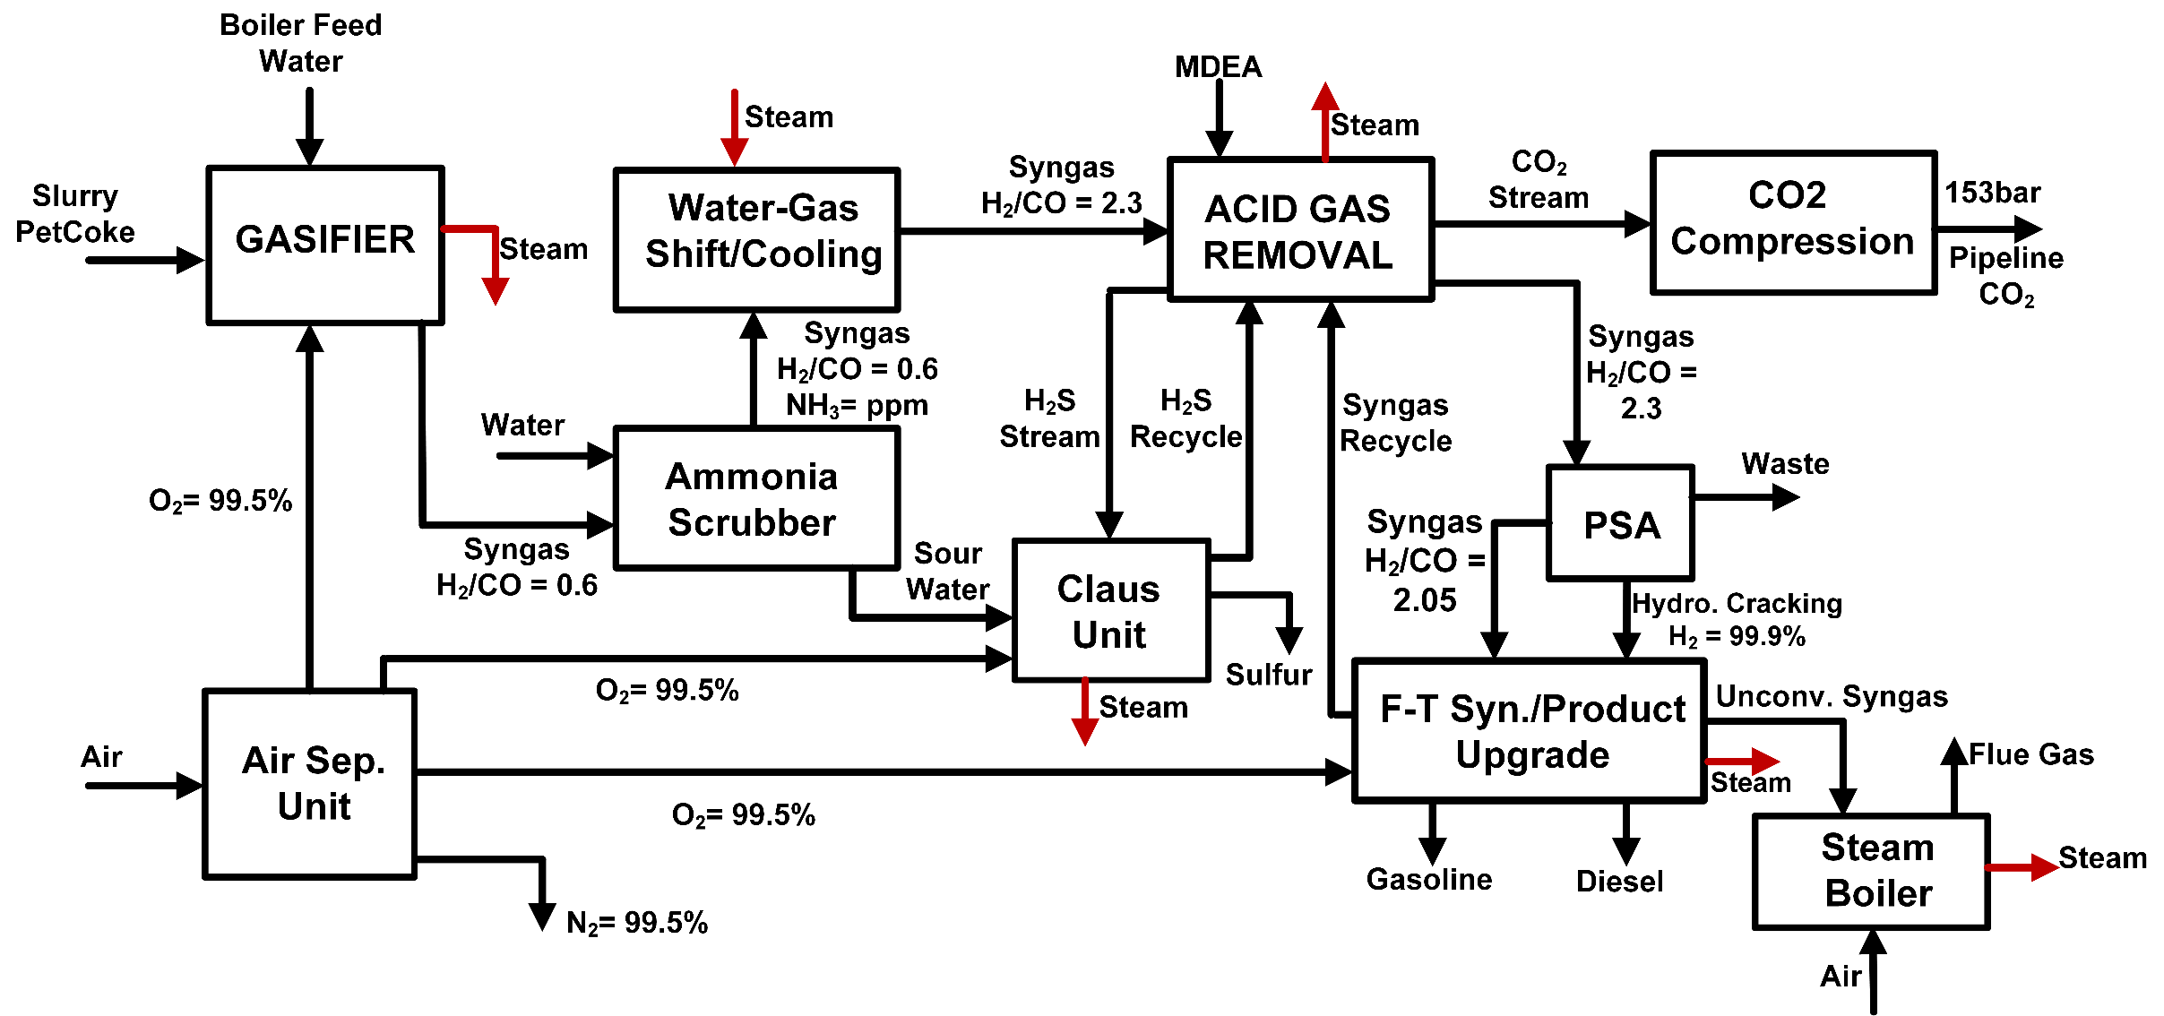
PSG (Petcoke Only Design)
Dr. Adams Group

Slide 5
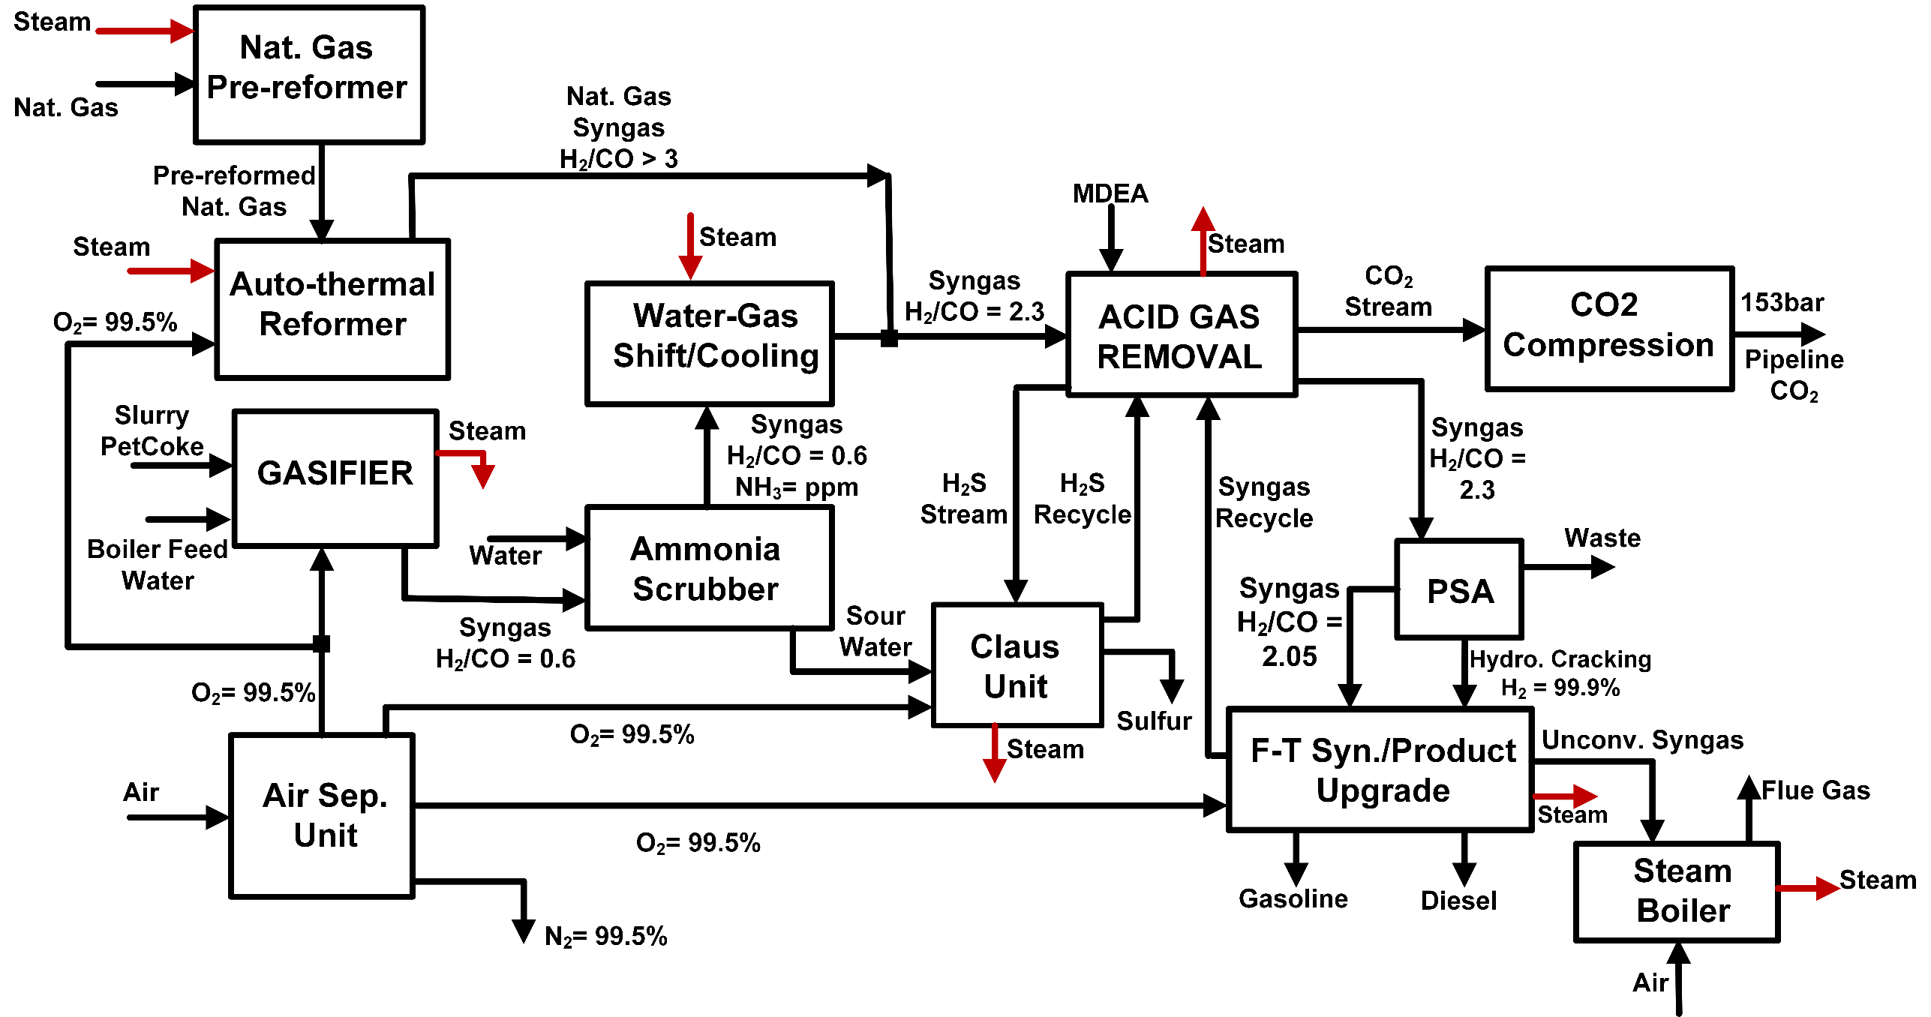
PG-ENGR (Petcoke + External NG Reformer)
Dr. Adams Group

Slide 6
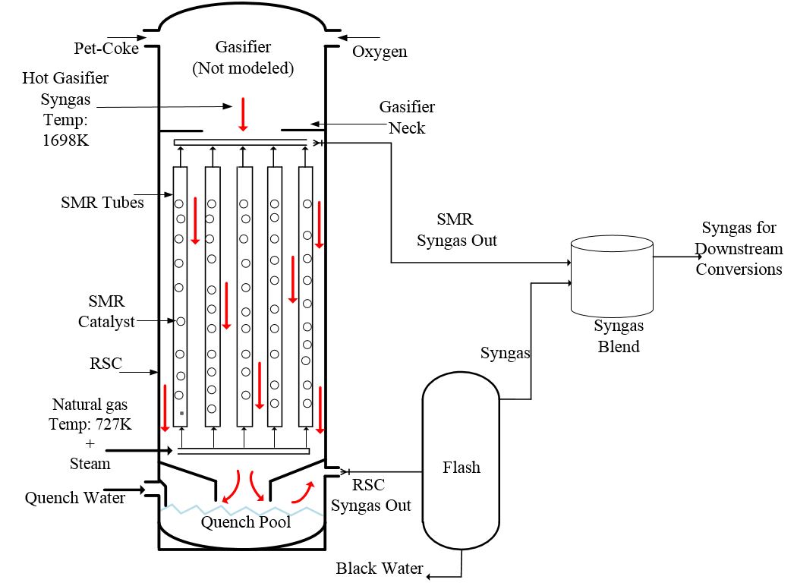
PG-INGR (Petcoke + Internal Reformer)
Ghouse, J.H., D. Seepersad, and T.A. Adams, Modelling, simulation and design of an integrated radiant syngas cooler and steam methane reformer for use with coal gasification. Fuel Processing Technology, 2015. 138: p. 378-389
Dr. Adams Group

Slide 7
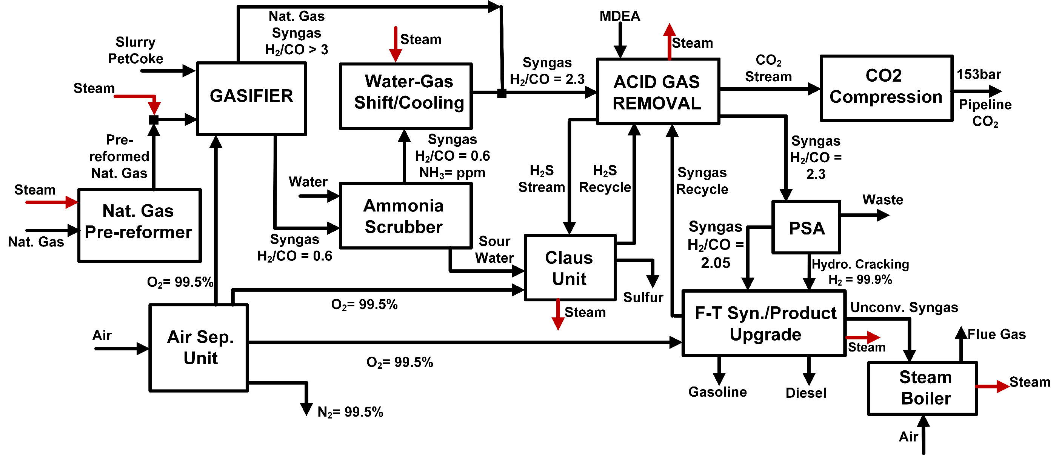
PG-INGR (Petcoke + Internal Reformer)
Dr. Adams Group

Slide 8
Heat Exchange Network Design
PSG: Petcoke only
PG-INGR: Petcoke + internal reformer
PG-ENGR: Petcoke + External reformer
CC: Composite Curve
Dr. Adams Group

Slide 9
Economic Assumptions
Discounted cash flow rate of return (DCFROR)
Capacity factor: 85%
Carbon Emission Tax
$50/tonneCO₂
Investment Parameters | Approach
Plant life (yrs) | 30
Construction Period (yrs) | 2.5
Debit/Equity | 80/20
Tax Rate | 40%
Internal Rate of Return (IRR) | 12%
Depreciation Method | MACRS
Operating hours | 8000
Dr. Adams Group

Slide 10
Results: Designs
PSG: Petcoke only
PG-INGR: Petcoke + internal reformer
PG-ENGR: Petcoke + External reformer
Dr. Adams Group

Slide 11
Results: Emissions & Efficiencies
$$η_{fuel}= \frac{{Diesel}_{HHV}+{Gasoline}_{HHV}}{{Fuel}_{HHV}}$$
$$η_{Energy}= \frac{{Diesel}_{HHV}+{Gasoline}_{HHV}}{{Fuel}_{HHV}+{Electricity}_{consumed}+{Utilities}_{consumed}}$$
PSG: Petcoke only
PG-INGR: Petcoke + internal reformer
PG-ENGR: Petcoke + External reformer
Dr. Adams Group

Slide 12
Results: Cost of CO₂ Avoided (CCA)
$$CCA= \frac{\left({TPC}_{CCS_plant}− {TPC}_{Refinery}\right)}{\left({GHG}_{Refinery}− {GHG}_{CCS_plant}\right)}$$
 | PSG | PG-INGR | PG-ENGR
CCS-Enabled | Yes | Yes | Yes
Total Capital Cost (M$) | 1116 | 1382 | 1370
Annualized Capital Cost (M$/yr) | 294 | 365 | 361
Operating Cost (M$/yr) | 235 | 345 | 315
Total Product (MGJ/yr) | 26.4 | 43.3 | 38.5
Total Product Cost ($/GJ) | 20.1 | 16.4 | 17.6
GHG (kgCO₂eq/GJ) | 18.72 | 23.32 | 15.6
CCA ($/tonneCO₂eq) | 459 | 237 | 193
${TPC}_{Refinery}$ = $14.72/GJ
${GHG}_{Refinery}$ = 30.38 kgCO₂eq/GJ
TPC = Total product cost
GHG = Greenhouse gas
Dr. Adams Group

Slide 13
Sensitivity Analysis: Natural Gas Price
Base case Price
Dr. Adams Group

Slide 14
Conclusion
Different petcoke conversion strategies were evaluated in terms of economics and environmental impacts.
Performance metrics employed were:
NPV
MDSP
Carbon, Fuel, and Energy Efficiencies
Overall, PG-INGR design showed to be a promising technology at current market condition.
Due to the ever-changing market conditions, a flexible PG-INGR configuration needs to be designed to ascertain its performance under uncertainty.
Dr. Adams Group

Slide 15
Acknowledgment
Supervisor
Dr. Thomas A. Adams II
Research funding:
NSERC Discovery grant
Dr. Adams Group

Slide 16
Thank You
Presentation slides available for download:
http://PSEcommunity.org/LAPSE:2018.0618
Dr. Adams Group

Slide 17
References
EIA Monthly Energy Review January 2017
BP Statistical Review of World Energy, June 2016
Murthy, B.N., et al., Petroleum coke gasification: A review. The Canadian Journal of Chemical Engineering, 2014. 92(3): p. 441-468.
Jacobs Consultancy, Executive Summary.
Ghouse, J.H., D. Seepersad, and T.A. Adams, Modelling, simulation and design of an integrated radiant syngas cooler and steam methane reformer for use with coal gasification. Fuel Processing Technology, 2015. 138: p. 378-389.
Saharei, 2016 Reduced Order Modeling & Scale-up of an Entrained Flow Gasifier PhD Thesis.
Netzer, D. and C. Wallsgrove, PETCOKE & METHANOL—1: Flow scheme envisions producing methanol for gasoline blending. Oil and Gas Journal, 2011. 109(13): p. 114.
Green, D.W., Perry’s chemical engineering handbook. McGrawHill Professional Publ, 2007.
Boushehri, A., et al., Equilibrium and transport properties of eleven polyatomic gases at low density. Journal of physical and chemical reference data, 1987. 16(3): p. 445-466.
Guevara, F., B. McInteer, and W. Wageman, High‐Temperature Viscosity Ratios for Hydrogen, Helium, Argon, and Nitrogen. The Physics of Fluids, 1969. 12(12): p. 2493-2505.
Latto, B., Viscosity of steam at atmospheric pressure. International Journal of Heat and Mass Transfer, 1965. 8(5): p. 689-720.
Vargaftik, N.B., Handbook of thermal conductivity of liquids and gases. 1993: CRC press.
Uribe, F., E.A. Mason, and J. Kestin, Thermal conductivity of nine polyatomic gases at low density. Journal of physical and chemical reference data, 1990. 19(5): p. 1123-1136
Chase, M.W., Jr., NIST-JANAF Themochemical Tables, Fourth Edition, J. Phys. Chem. Ref. Data, Monograph 9, 1998, 1-1951
Dr. Adams Group

Slide 18
Heat Exchange Network Design
CC: Composite Curve
Dr. Adams Group

