Slide 1

Techno-economic System Analysis for SOFC/GT Hybrid System Accounting for Degradation Effects
AIChE
October 30, 2018
Haoxiang (Hundey) Lai
Supervisor: Dr. Thomas A. Adams II
Department of Chemical Enigneering
McMaster University

Slide 2
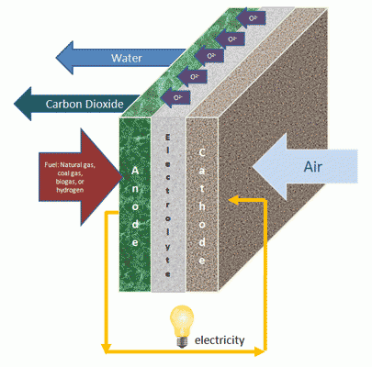
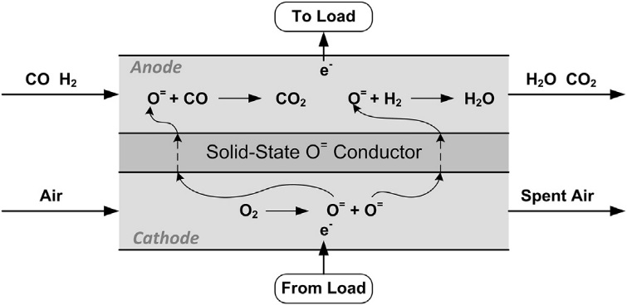
SOFC Overview
High electrical efficiency ~60% (cell level)
Lower greenhouse gas emission than conventional power plant (coal/natural gas power plant)
Sources: U.S. DOE, Also: Materials System Research, Inc.
Adams, Nease, Tucker, & Barton. I&EC Research (2013)

Slide 3
Research Motivation
Challenge: SOFC degrades over time
New!
Operating Mode | Constant Power Mode | Constant Voltage Mode
SOFC Degradation | Fast (and increasing) | Slow
Lifetime | Up to ~1.5 years | 13 – 14 years
Power output | Constant (baseload power) | Decreasing, not useful for baseload
Fuel | Increasing fuel flow | Increasing unspent fuel flow
    For baseload power production, one solution is to be coupled with gas turbine (GT) in a SOFC/GT hybrid system* Key discovery
Source: Tucker Sepulveda, and Harun, Journal of Fuel Cell Science and Technology (2014)

Slide 4
SOFC/GT Hybrid System
Operated in constant voltage mode
Power decreases as SOFC degrades
Over sized the turbine (sized at the end of lifetime of SOFC)
Power increases to almost make up for the SOFC power losses

Slide 5
Research Goal
We would like to answer whether it is better to have
An SOFC standalone plant (Case i)
  SOFC constant power mode, replace SOFC every 1.5 years
2. An SOFC/GT hybrid plant (more expensive) (Case ii)
SOFC constant voltage mode, replace SOFC every 13-14 years
For total baseload power production of 550 MW
The first system-level techno-economic analysis for SOFC/GT hybrid plant accounting for detailed SOFC degradation
Contribution to the early large-scale adoption of SOFC from a system-level perspective

Slide 6
SOFC Standalone Plant (Case i)

Slide 7




SOFC/GT Hybrid Plant (Case ii)
Model Simulations
Dynamic model*, pause in each time step (weekly)
Pseudo steady-state approach
Integrate models by using interfaces:
Aspen Excel Workbook & VBA
Matlab
Aspen Plus steady-state model
Source: Zaccaria, Tucker, and Traverso, Journal of Power Sources (2016)

Slide 8
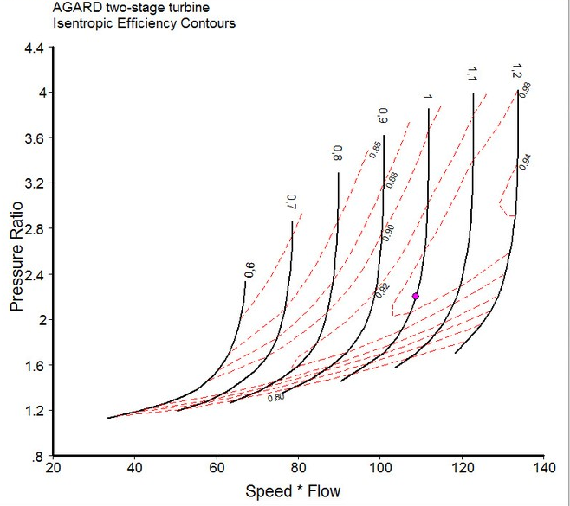
Model Simulations
Steps
Aspen Plus steady-state model
Simulink dynamic SOFC model
  Overall degradation model
  Localized degradation model
Model integration
Simulations of the integrated models
Estimation of equipment sizes
Re-simulations with size constraints
  Key constraints: Turbine size
  suitable turbine map
Economic analysis
- current stage
Example of a typical turbine map*
Source: http://www.gasturb.de/

Slide 9
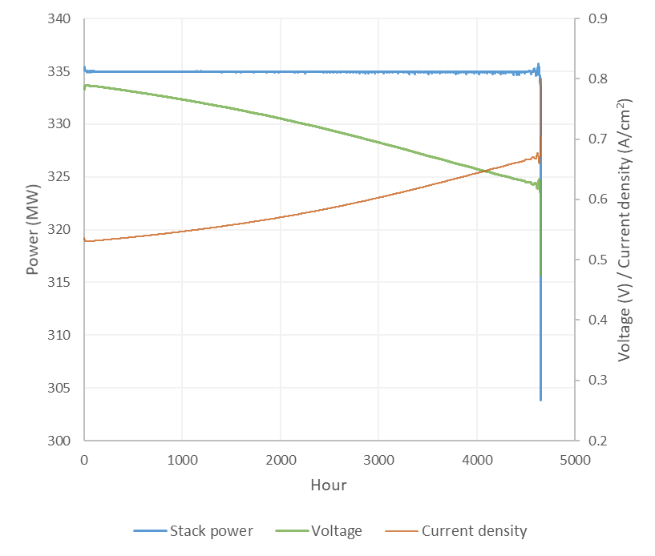
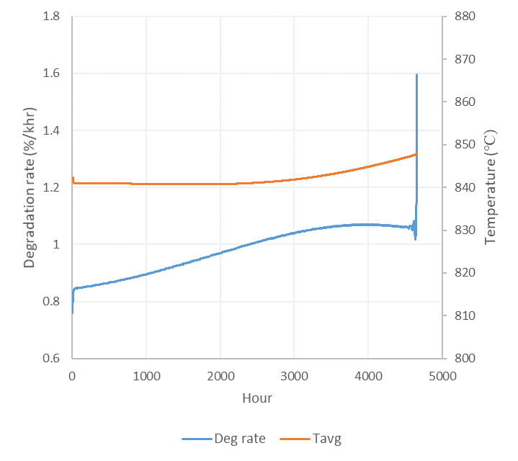
Preliminary Results – Case i
SOFC Standalone Plant – Overall degradation model
Fuel cell lifetime: ~ 4656 hours = ~ 28 weeks = ~ 6.5 months
Constant power and fuel utilization

Slide 10
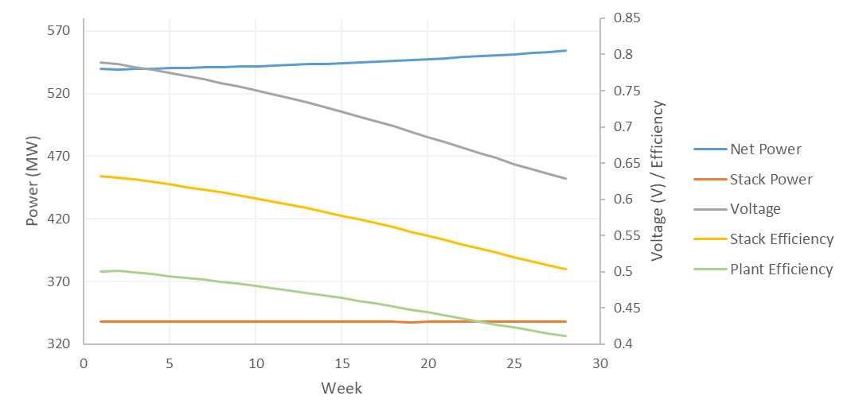
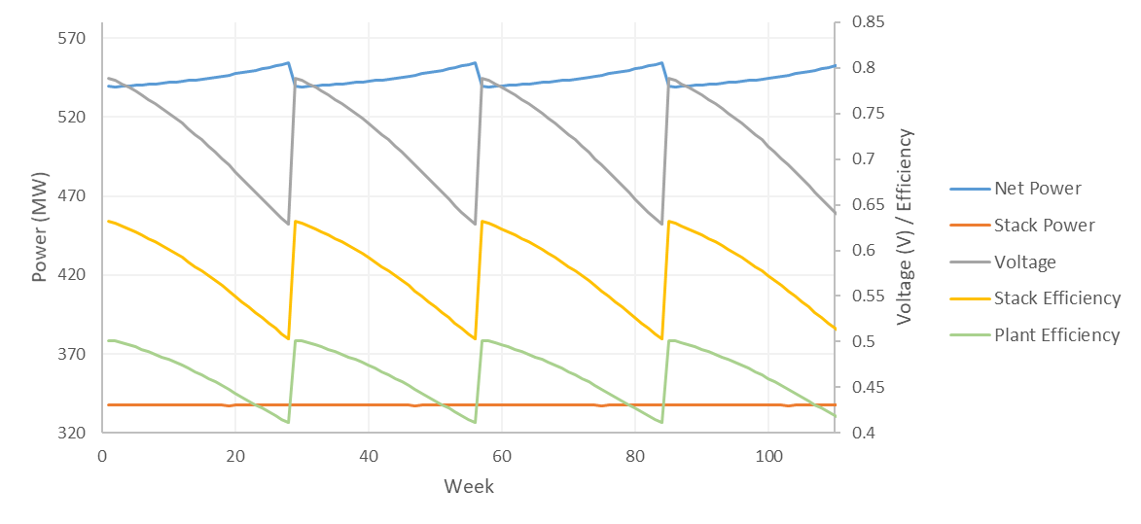
Preliminary Results
SOFC Standalone Plant – Overall degradation model and balance-of-plant Aspen model (steam bottoming cycle)
Replace the fuel cell in the plant every 28 weeks

Slide 11
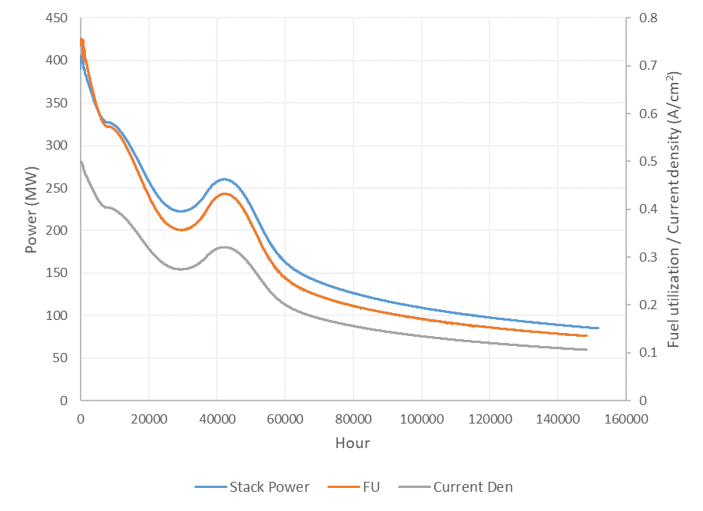
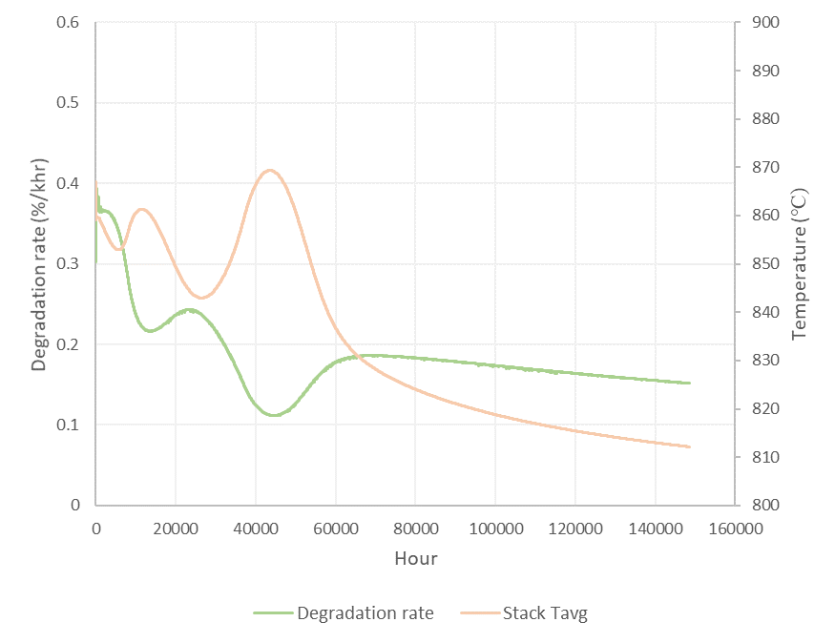
Preliminary Results
SOFC/GT Hybrid Plant – Overall degradation model
Fuel cell lifetime: ~1.5 x 10⁵ hours = ~ 905 weeks = ~ 17 years
Constant voltage and net power
We need to develop a good temperature controller

Slide 12
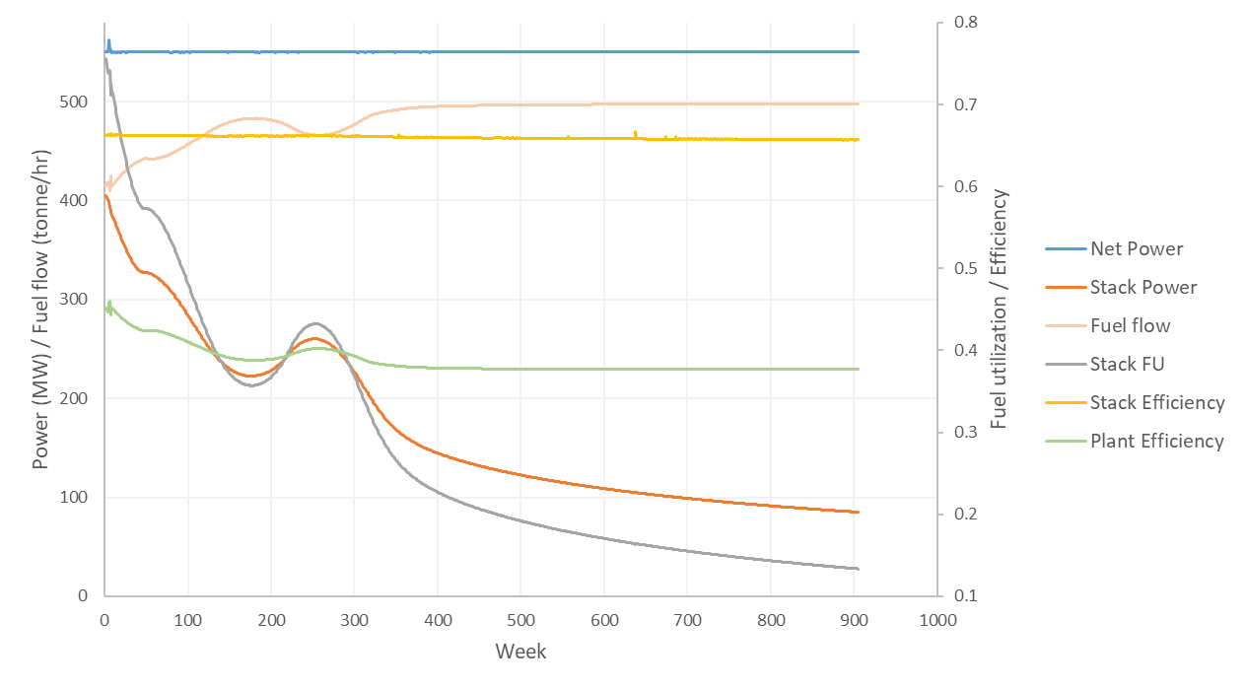
Preliminary Results
SOFC/GT Hybrid Plant – Overall degradation model and balance-of-plant Aspen model (gas turbine)
Assumed linear turbine efficiency increase with respect to gas flow

Slide 13
Preliminary Results
Estimation considering a 17-year-period (the lifetime of the Hybrid plant)
 | Coal Power Plant | SOFC Standalone Plant | SOFC/GT Hybrid Plant
Fuel Cells required |  | 32 stacks (2.02 million cells/stack) | 1 stack (2.45 million cells/stack)
Turbine required |  | 250 MW Steam turbine (HP/IP/LP stages)* | 2 Gas turbines (250 MW each)*
Plant Efficiency | ~ 33%* | 46% | 38.7%
CO₂ emission | ~ 1 kg/kWh* | 0.45 kg/kWh | 0.53 kg/kWh
can be optimized
Sources: Siemens, https://www.siemens.com/global/en/home/products/energy/power-generation
EIA, https://www.eia.gov/electricity/annual/html/epa_08_01.html, https://www.eia.gov/electricity/data/emissions/

Slide 14
Next Step
Modify and integrate the SOFC localized degradation model to the model simulation
Include turbine map in the model
Detailed economic analysis
Parametric study for Case ii
Keep constant fuel utilization or allow it to drop
Decrease initial current density and increase the SOFC stack size
Increase the cathode inlet temperature
Design turbine sizes according to different initial conditions or fix turbine sizes for any initial condition

Slide 15



Conclusions
Presented a trade-off between the standalone SOFC plant and SOFC/GT hybrid plant by using preliminary simulation results (overall degradation model)
  Standalone SOFC plant: higher efficiency, lower CO₂ emission, expected to be much more expensive
  SOFC/GT hybrid plant: sacrifice a little bit of efficiency but expected to be much cheaper
Acknowledgements

Slide 16
Thank you

