Slide 1
Accelerating Design of Chemical Recycling of Plastic Waste through Digitalization: A Bubbling Fluidized Bed Reactor Case Study
Stefano Iannello, Vassilis Charitopoulos, Massimiliano Materazzi
ESCAPE36, 22/06/2026
Department of Chemical Engineering
© 2026 Stefano Iannello

Slide 2
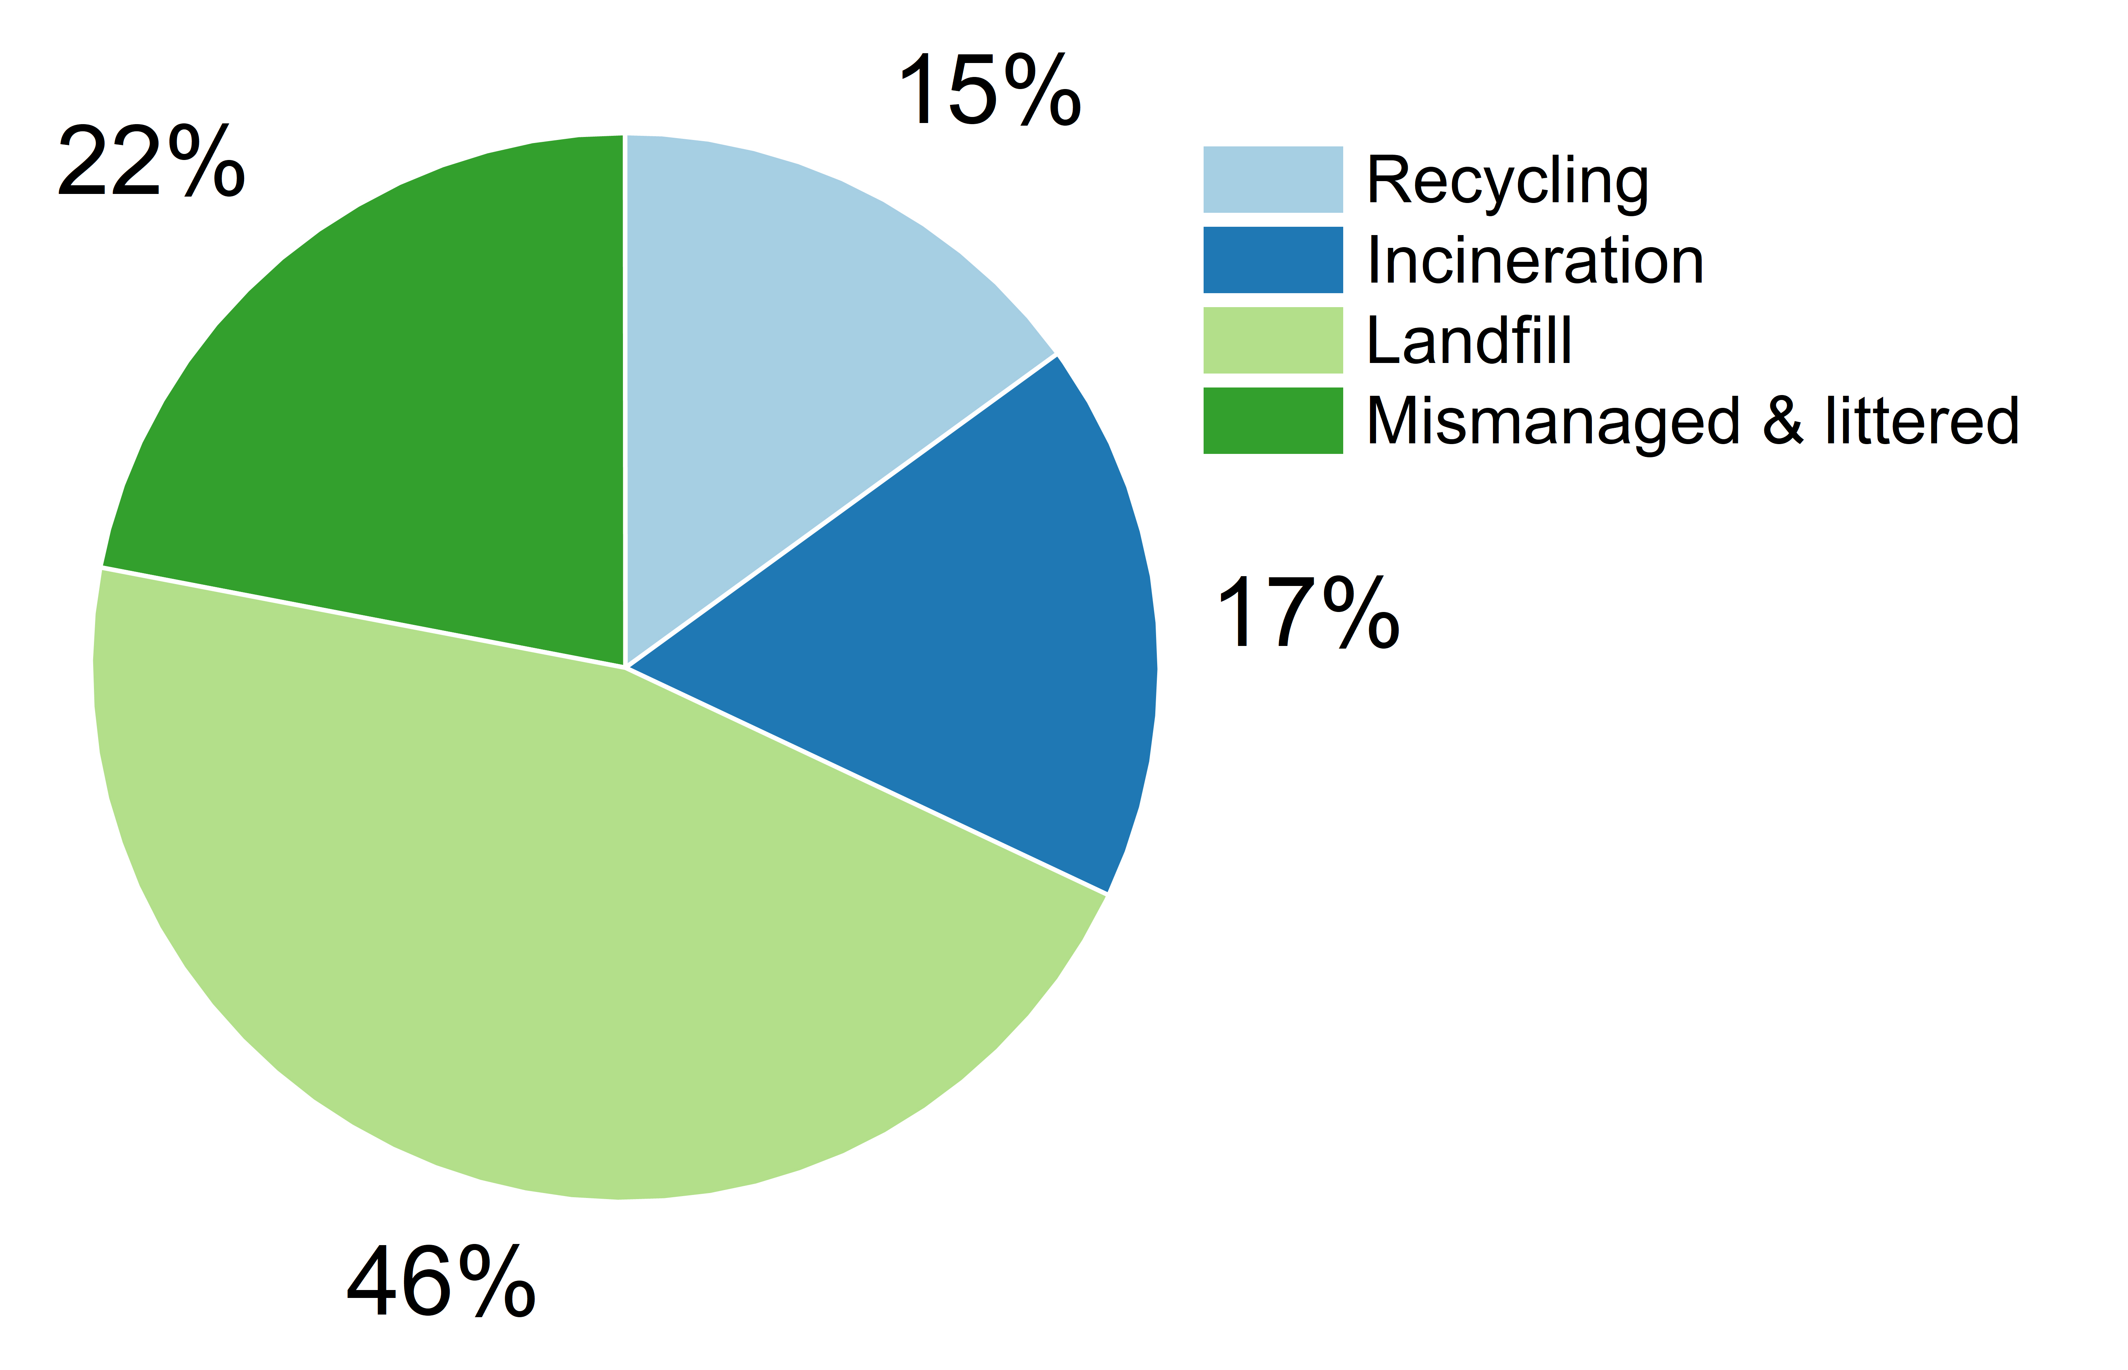
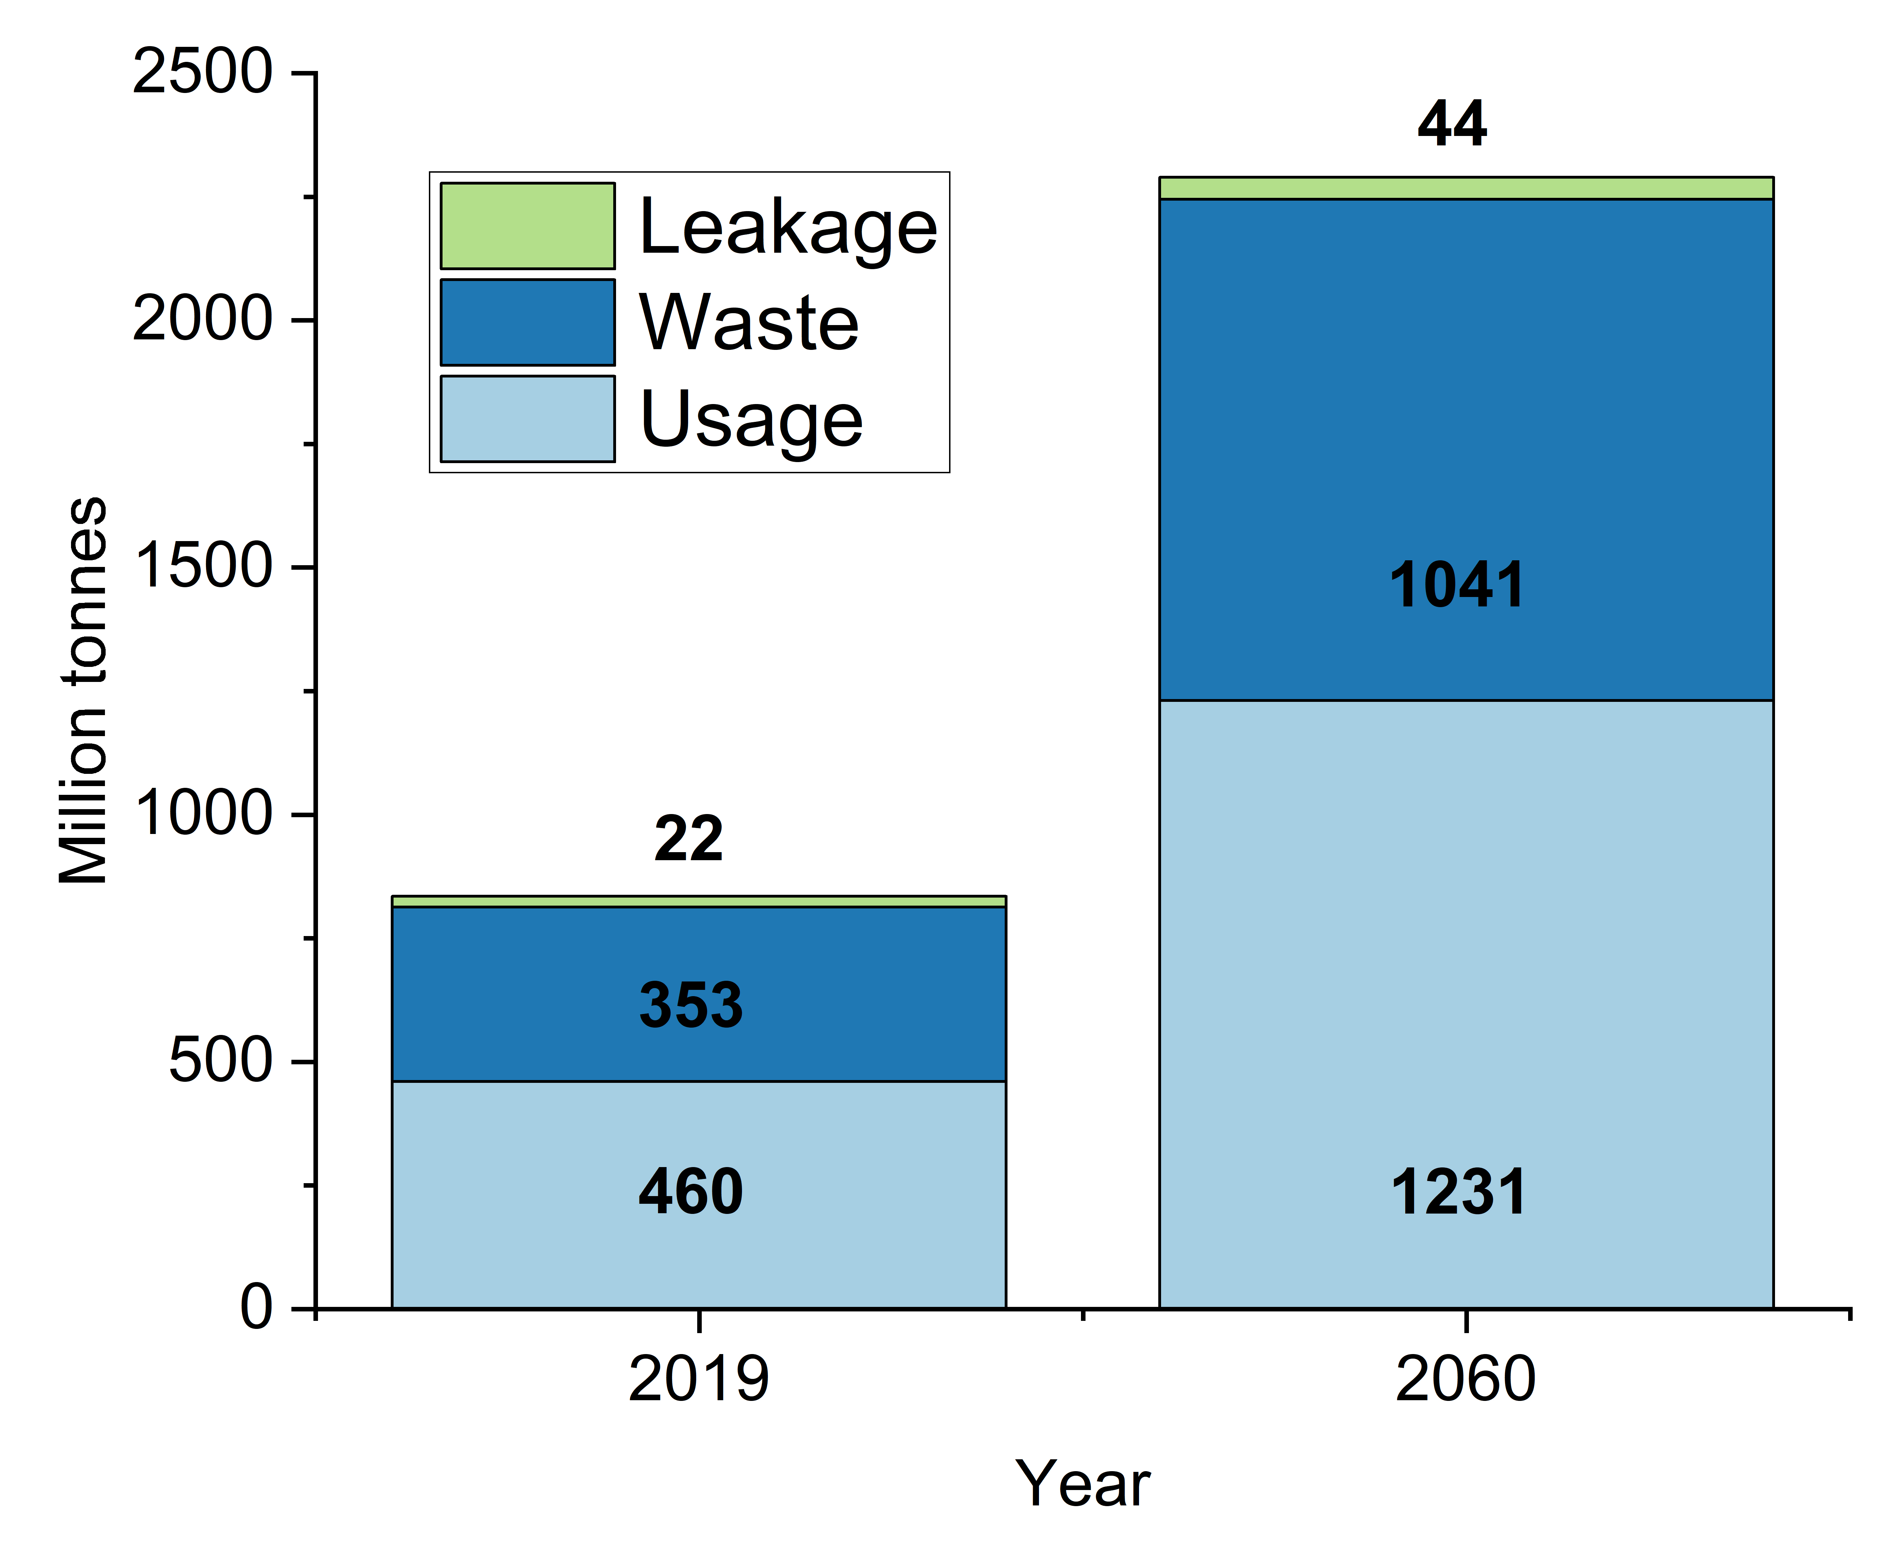
Plastic waste outlook
The amount of plastic waste produced globally will almost triple by 2060.
Global leakage to the environment (terrestrial and aquatic) will double by 2060.
An estimated 68% of the waste fraction is not managed properly, littered or disposed in landfills.
Source: Global Plastics Outlook, OECD (2022)
© 2026 Stefano Iannello

Slide 3
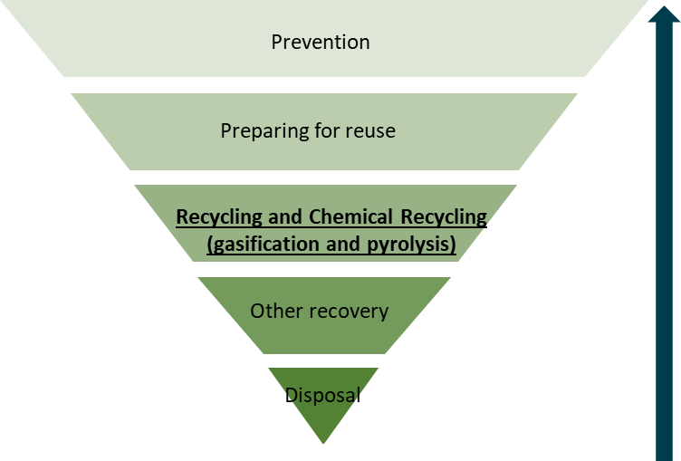
Plastic waste outlook
The amount of plastic waste produced globally will almost triple by 2060.
Global leakage to the environment (terrestrial and aquatic) will double by 2060.
An estimated 68% of the waste fraction is not managed properly, littered or disposed in landfills.
Comparable/lower environmental impact then incineration with energy recovery.
Opportunity for chemical manufacturing and circular economy: net-zero.
Source: Global Plastics Outlook, OECD (2022)
Source: DEFRA – Waste management plan for England (2021)
© 2026 Stefano Iannello

Slide 4
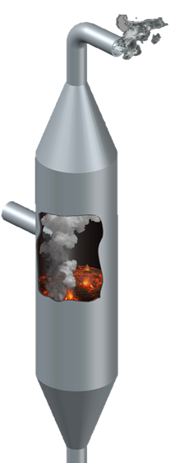
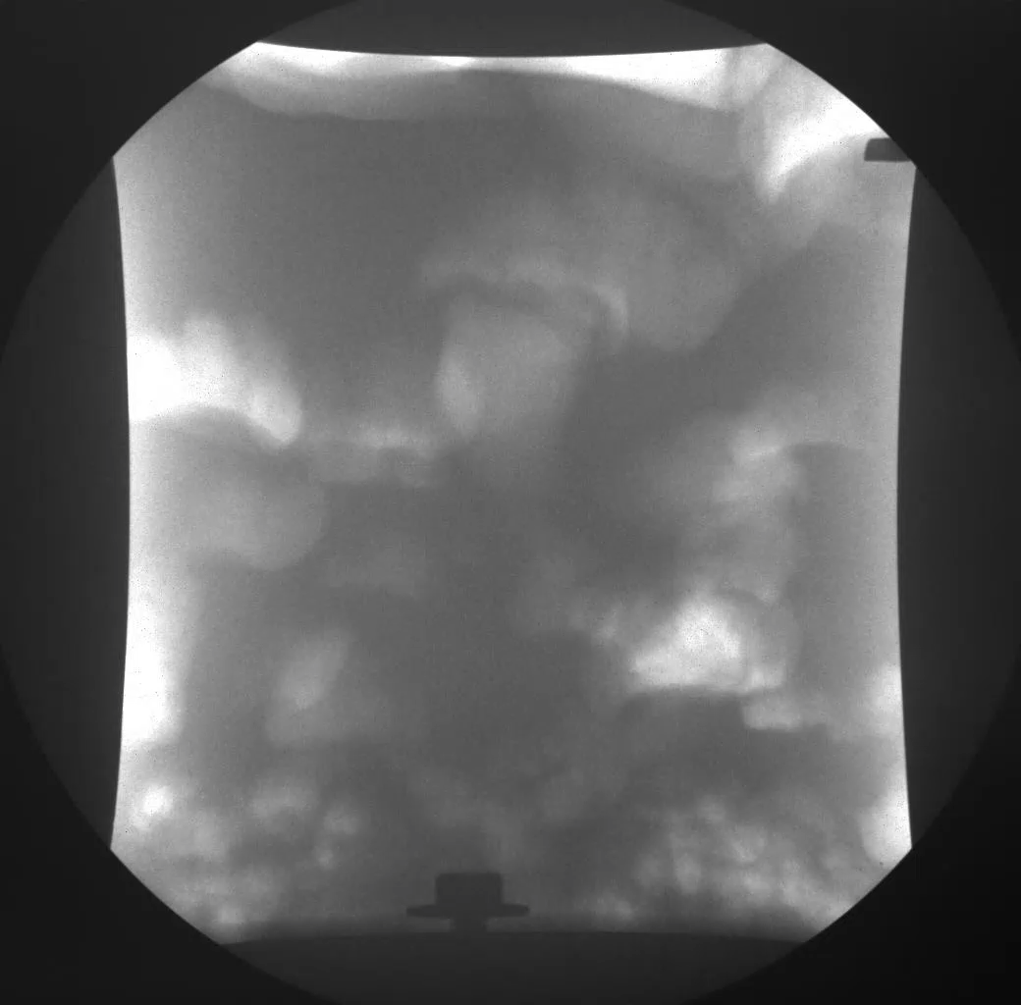
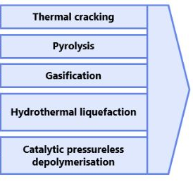
Fluidized bed for thermochemical conversions
Low cost, locally available feedstock.
Abundant component of Municipal Soid Waste (MSW).
Source of C and H.
X-ray visualization
Waste feedstock
Olefins
Plastics
Chemicals
Solvents
Fluidizing medium
© 2026 Stefano Iannello

Slide 5
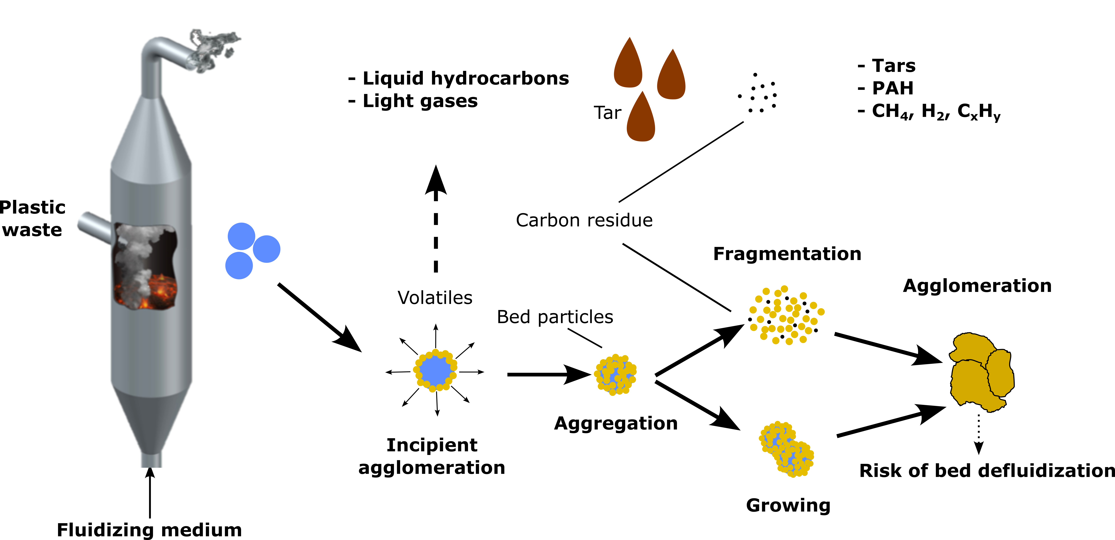
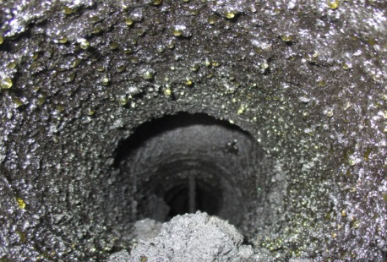
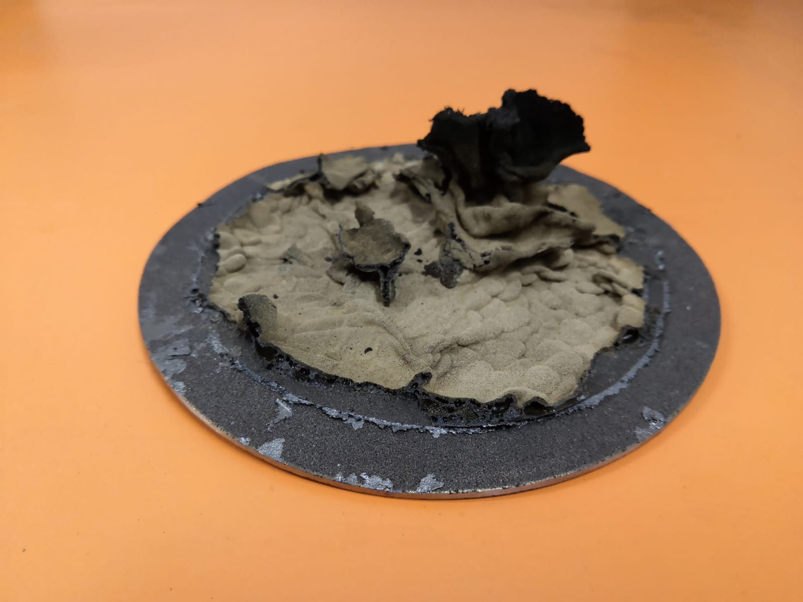
Fluidized bed for thermochemical conversions
Key Challenges
Tar condensation on heat exchange surfaces
Segregation/
mixing
Agglomeration between sand/plastic on the distributor
© 2026 Stefano Iannello

Slide 6
Modelling pathways
“There is a need for suitable modelling approaches to properly inform the design stage and mitigate operational risks”
Mechanistic models
Data-driven
Hybrid
First principles
M&EB, Thermodynamics
Empirical data
Machine Learning, Deep Learning,
AI
First principles + Data
Surrogates,
PINNs,
NODEs
© 2026 Stefano Iannello

Slide 7
Aim and Objectives
“Provide a method to aid design of bubbling fluidized bed reactors for chemical recycling ”
To develop a physics-driven optimization framework for operability analysis.
To quantify operability limits.
To identify the optimal operating conditions that minimize the tar yield.
© 2026 Stefano Iannello

Slide 8
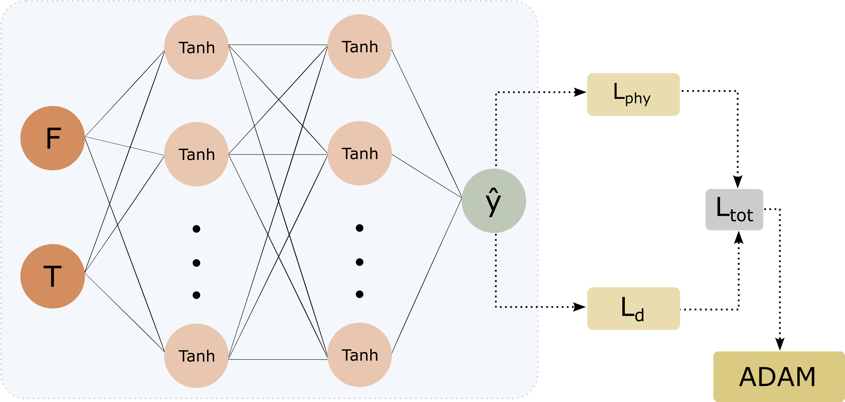


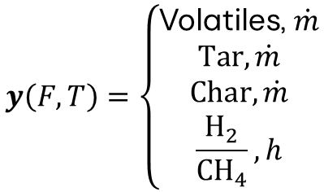
Methodology
Mechanistic model
Physics-Informed Surrogate (PINN)
$$1y\left(F,T\right)=AT+B$$
$$y\left(F,T\right)=\left\{\begin{aligned}\text{Volatiles}\text{, }\dot{m} \\ Tar,\dot{m} \\ Char,\dot{m} \\ \frac{H_{2}}{{CH}_{4}}, h\end{aligned}\right.$$
PP feed, F
Temperature, T
Fluidized bed
A, B : vector of coefficients (exp)
o
Fluidizing medium (N₂)
¹Vitale A, Di Carlo A, Foscolo P U, Papa A A. Kinetic Model Implementation of Fluidized Bed Devolatilization. Energies 17 3154 (2024) https://doi.org/10.3390/en17133154
© 2026 Stefano Iannello

Slide 9
Methodology
Adaptive PINN-driven feasibility analysis and optimization
1. Initial sampling
5. Evaluate PINN residuals
9. Evaluate the feasibility region
𝑜
2. Output for training
6. Evaluate acquisition
10. Find optimum within Ω
𝑎
𝑚
𝑡
3. Train PINN
7. Select new sample
11. Evaluate optimum robustness
𝑎
𝑚
𝑎
𝑚
4. Sample N_{c} points
8. Update training set
© 2026 Stefano Iannello

Slide 10



Methodology
Optimum robustness analysis
Parameter | Description | Value/Name
F_{min}, F_{max} | Bounds of plastic mass feed flow rate | 20 - 30 kg/h
T_{min}, T_{max} | Bounds of BFB temperature | 650 - 850 kg/h
N₀ | Number of initial design points (LHS) | 100
N_{c} | Number of samples in the dense pool of candidate points (LHS) | 5000
iter | Maximum number of adaptive sampling iterations | 200
N_{layers} | Number of PINN hidden layers | 1
N_{neurons} | Number of PINN hidden neurons | 20
η | Learning rate for Adam optimizer | 1e-3
N_{epochs} | Number of PINN training epochs | 7000
ε | Mass balance residual tolerance | 1e-2
h_{min}, h_{max} | Bounds of H₂/CH₄ ratio | 0.4 – 0.6
N_{δ} | Number of perturbations per iteration | 5000
σ | Standard deviation for perturbation | 0.3
1. Local perturbation
2. Robustness metrics
$$FRR=\frac{N_{feas}}{N_{δ}}$$
Feasible retention ratio
$$σ_{tar}=\frac{∆{\hat{m}}_{tar}}{{\hat{m}}_{tar}^{∗}}$$
Relative uncertainty
$$RI=\left(1−σ_{tar}\right) FRR$$
Robustness index
© 2026 Stefano Iannello

Slide 11
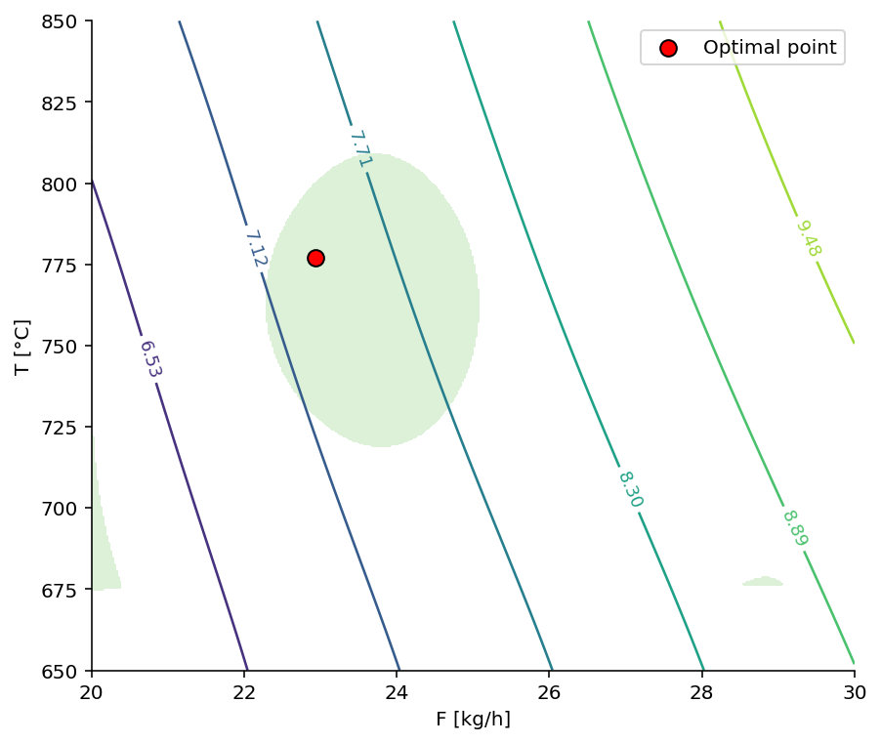
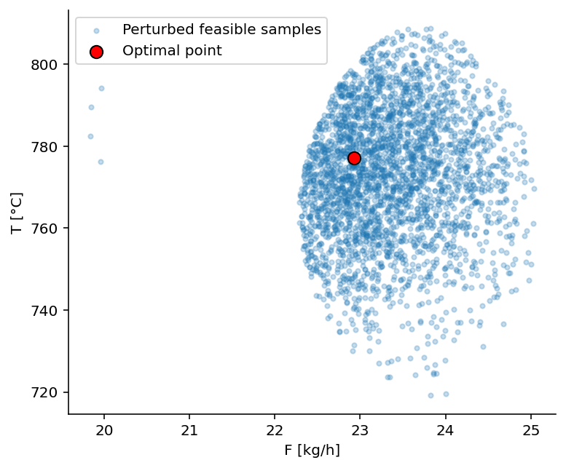
Results
191 adaptive samples
Tar iso-contours
© 2026 Stefano Iannello

Slide 12
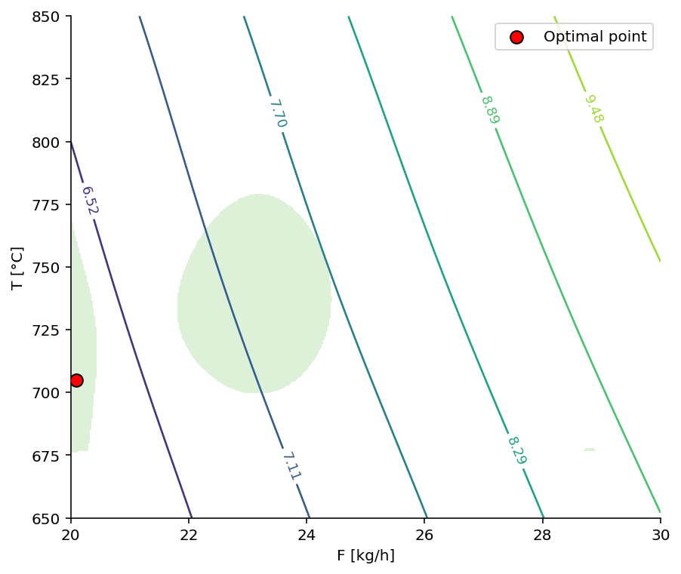
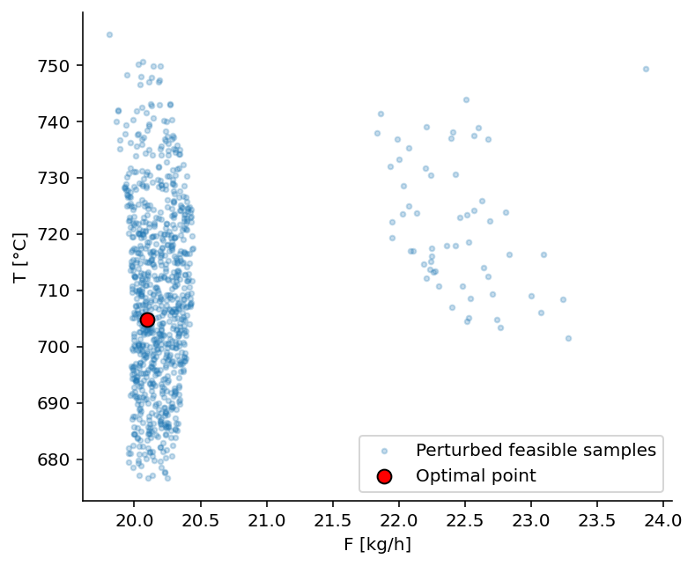
Results
200 adaptive samples
Tar iso-contours
© 2026 Stefano Iannello

Slide 13
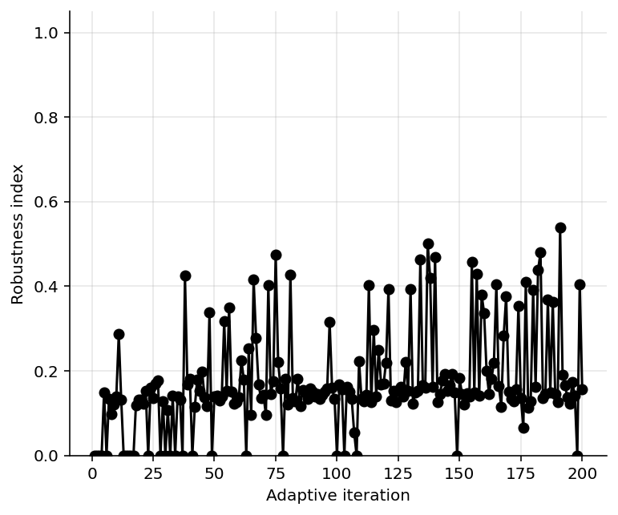
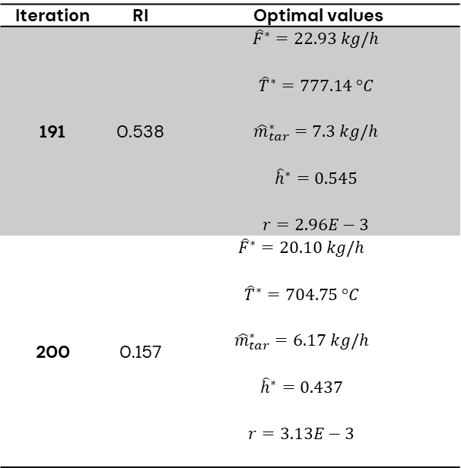
Results
Iteration | RI | Optimal values
191 | 0.538 | $${\hat{F}}^{∗}=22.93 kg/h$$ $${\hat{T}}^{∗}=777.14 °C$$ $${\hat{m}}_{tar}^{∗}=7.3 kg/h$$ $${\hat{h}}^{∗}=0.545$$ $$r=2.96E−3$$
200 | 0.157 | $${\hat{F}}^{∗}=20.10 kg/h$$ $${\hat{T}}^{∗}=704.75 °C$$ $${\hat{m}}_{tar}^{∗}=6.17 kg/h$$ $${\hat{h}}^{∗}=0.437$$ $$r=3.13E−3$$
© 2026 Stefano Iannello

Slide 14
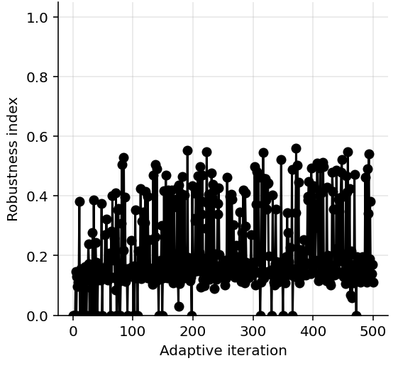
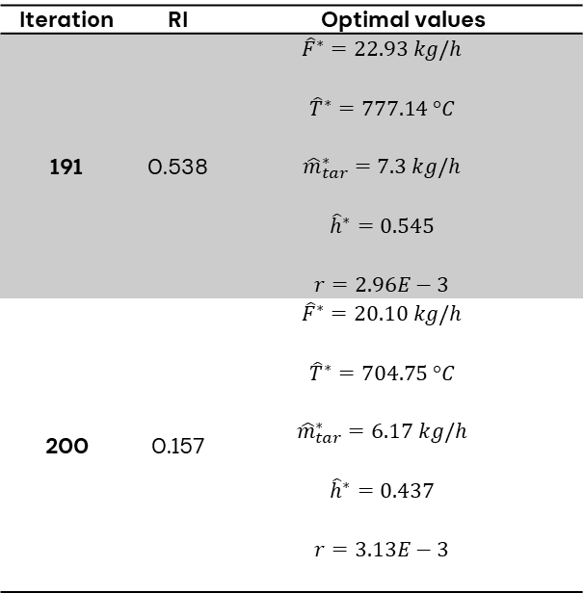
Results
Iteration | RI | Optimal values
191 | 0.538 | $${\hat{F}}^{∗}=22.93 kg/h$$ $${\hat{T}}^{∗}=777.14 °C$$ $${\hat{m}}_{tar}^{∗}=7.3 kg/h$$ $${\hat{h}}^{∗}=0.545$$ $$r=2.96E−3$$
200 | 0.157 | $${\hat{F}}^{∗}=20.10 kg/h$$ $${\hat{T}}^{∗}=704.75 °C$$ $${\hat{m}}_{tar}^{∗}=6.17 kg/h$$ $${\hat{h}}^{∗}=0.437$$ $$r=3.13E−3$$
378 iterations
~0.56
© 2026 Stefano Iannello

Slide 15
Conclusions
The proposed PINN with mass balance constraint and adaptive sampling framework accurately identifies feasible operating regions for BFB plastic pyrolysis.
Robustness-aware optimization shows that the most reliable operating point may occur before full convergence, highlighting that optimality and robustness are not always aligned.
The integrated framework enables efficient operability mapping and tar minimization while reducing reliance on expensive mechanistic simulations.
Recommendations
The framework is demonstrated only on a simplified, low-dimensional reactor case study.
This study is proof of concept based on a semi-empirical model, thus its industrial applicability is currently limited.
© 2026 Stefano Iannello

Slide 16
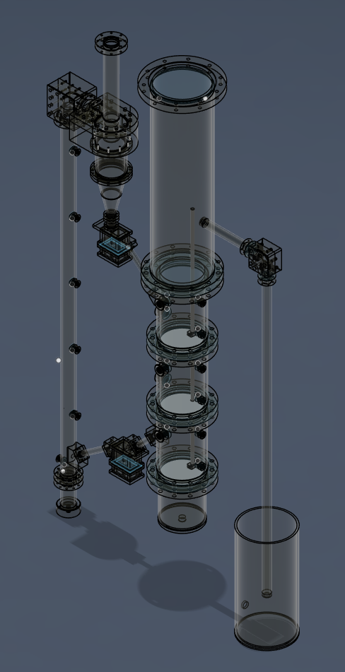
Future works
Validate the proposed framework using experimental data and industrial-scale BFB pyrolysis plant measurements.
Extend the methodology to higher-dimensional and dynamical systems with additional process variables, constraints, and alternative reactor configurations.
Potential expansion into real-time optimization/control strategies.
Circulating fluidized bed for plastic chemical recycling
Under construction at UCL Chemical Engineering Dpt
© 2026 Stefano Iannello

Slide 17
Thank you
stefano.iannello.18@ucl.ac.uk
Stefano Iannello, Vassilis Charitopoulos, Massimiliano Materazzi
ESCAPE36, 22/06/2026
Department of Chemical Engineering
© 2026 Stefano Iannello

